Slide 1


Slide 2
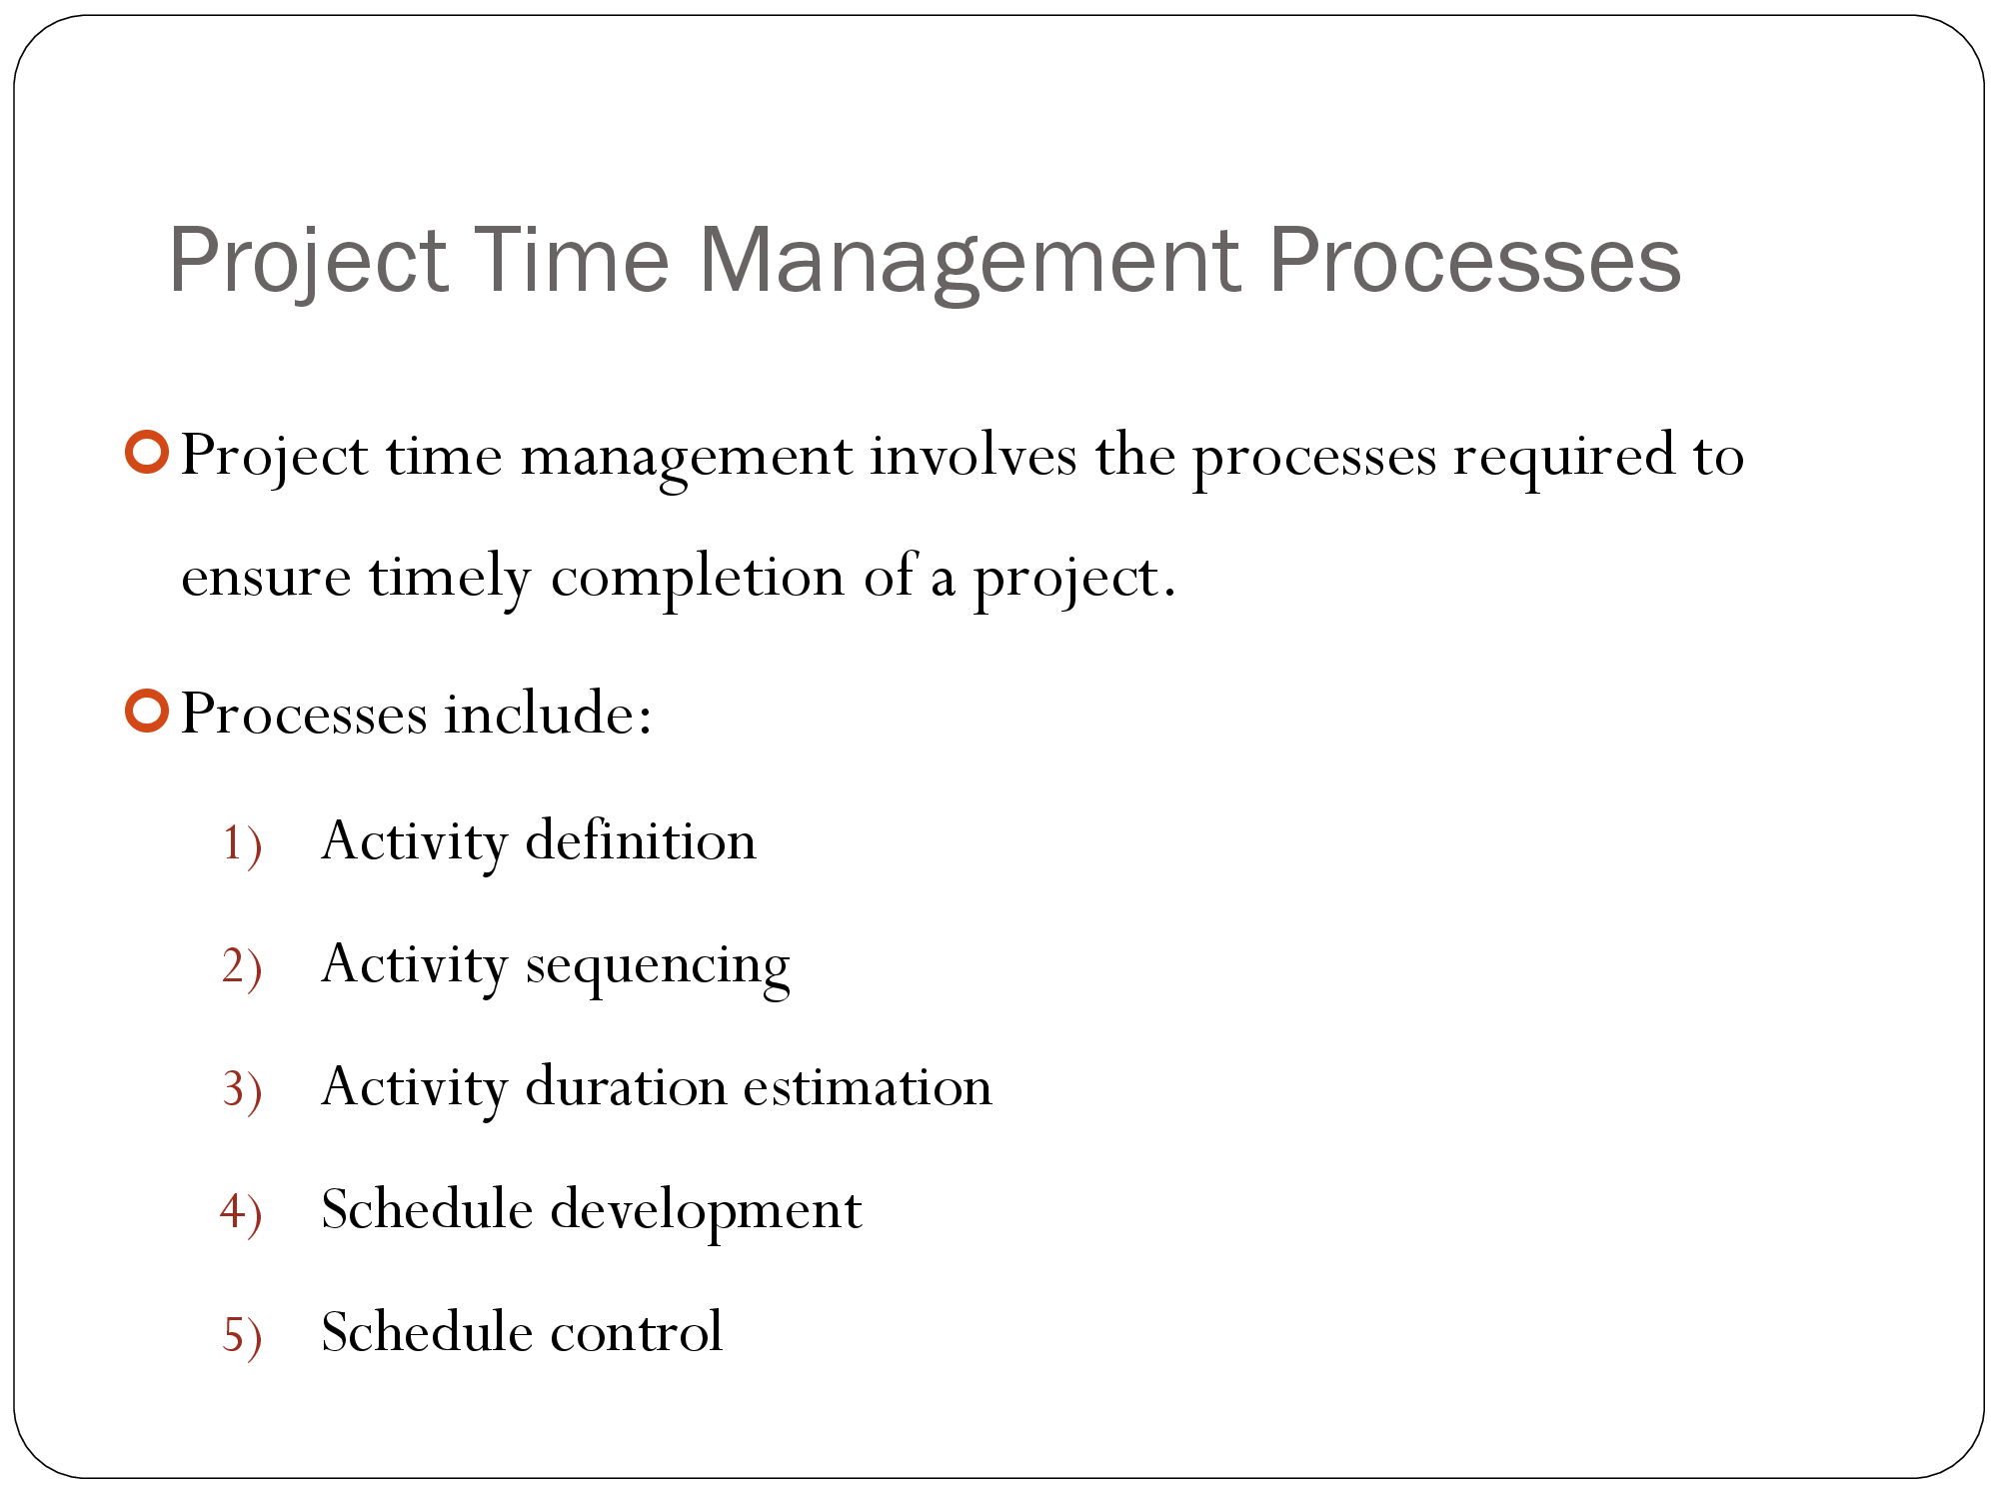

Slide 3
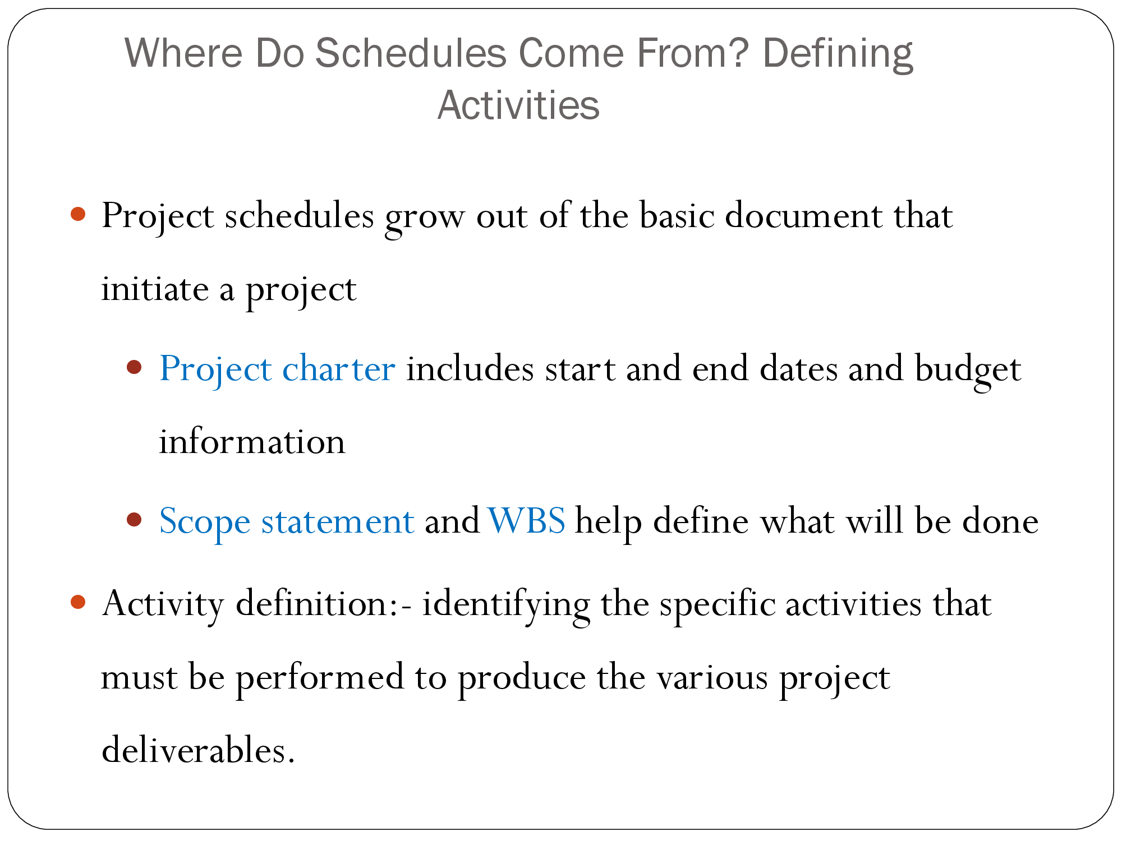

Slide 4
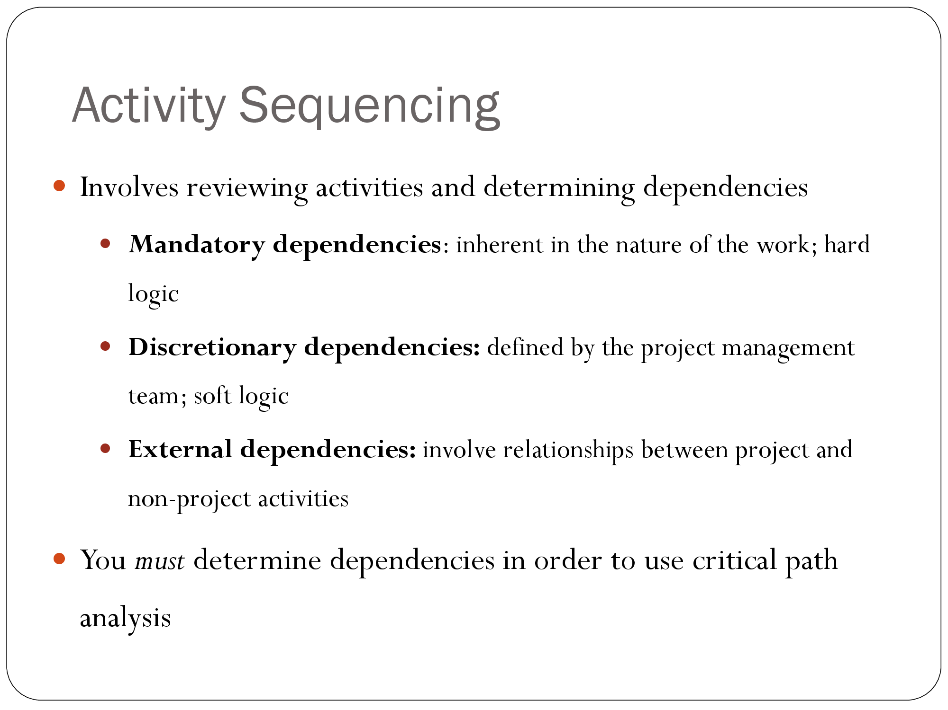
Notes:
Mandatory Dependencies:-These dependencies are based on the physical or logical relationship between tasks and the order in which they must be completed. For example, the installation of a foundation must be completed before building construction can begin.

Slide 5
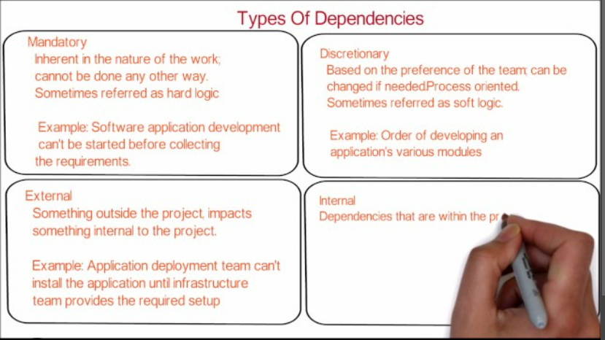

Slide 6
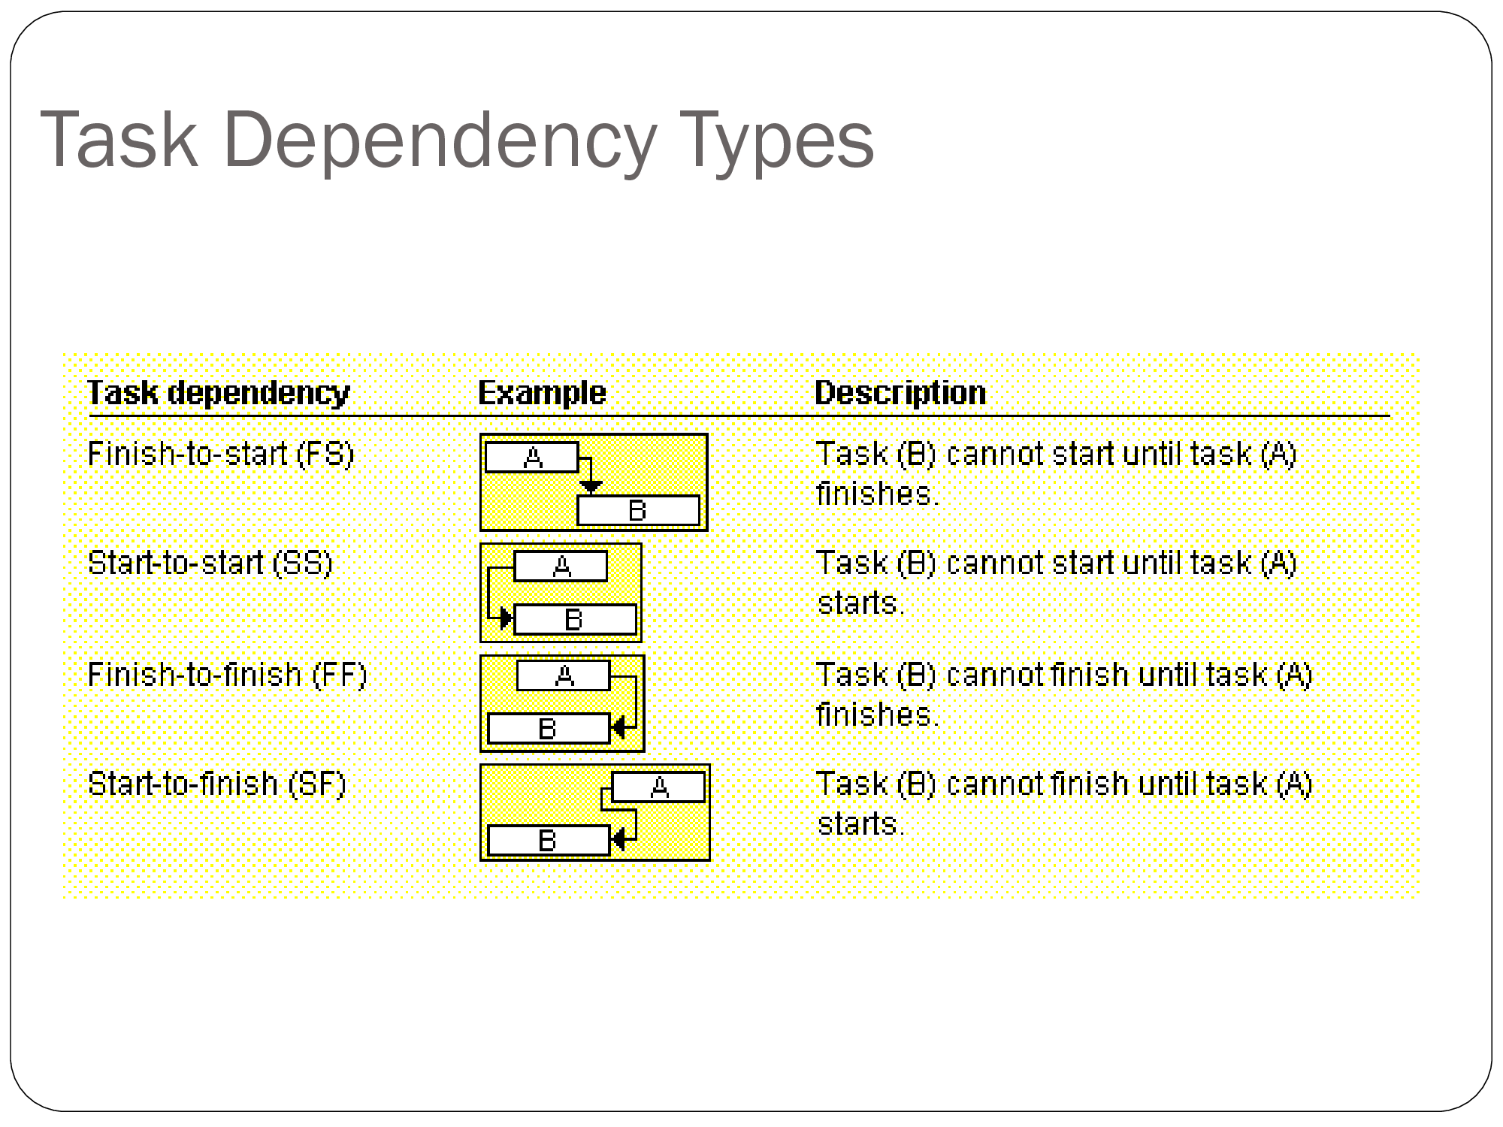

Slide 7
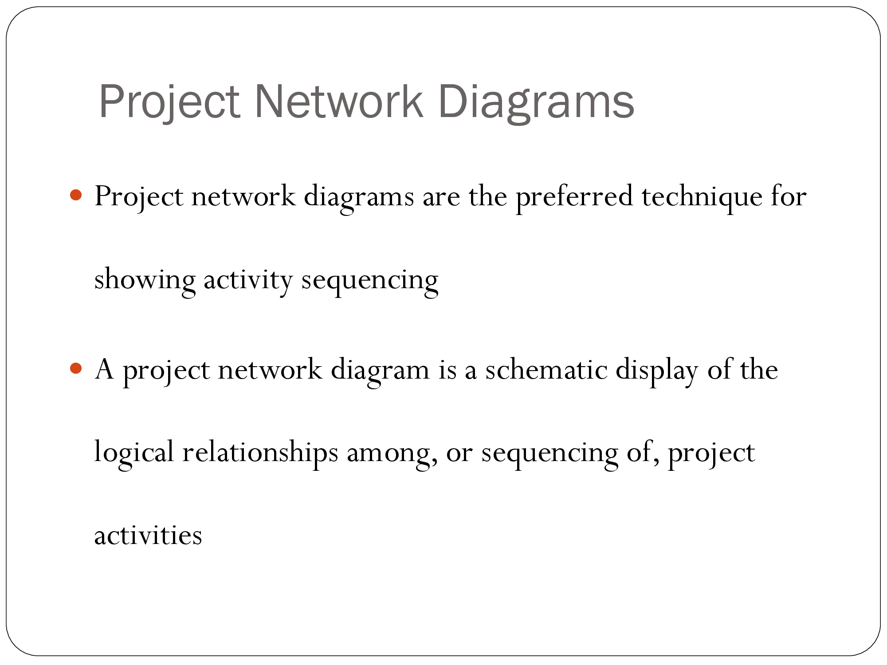

Slide 8
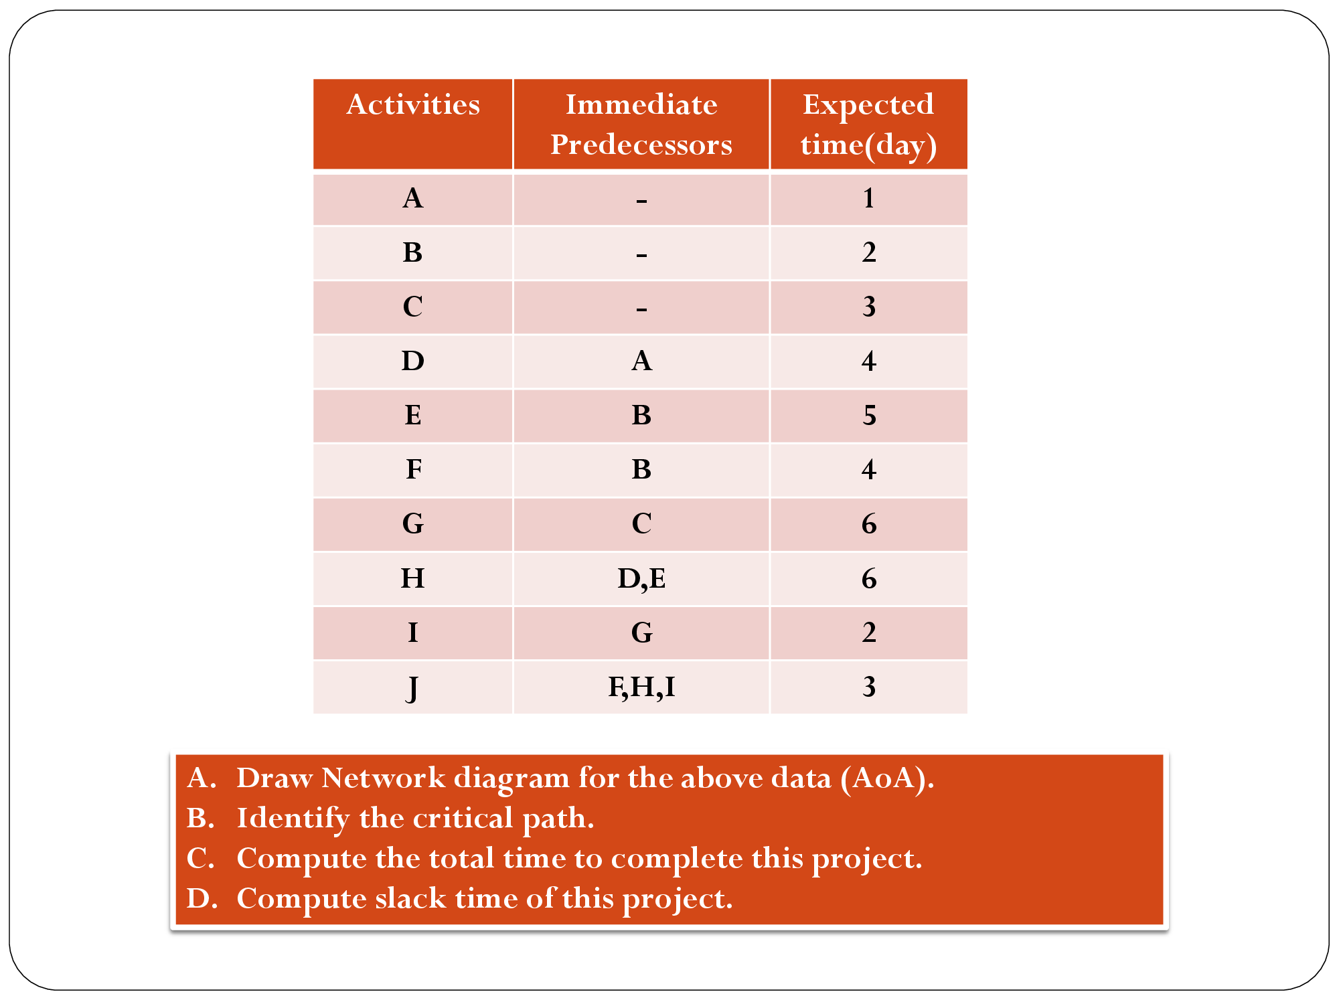

Slide 9
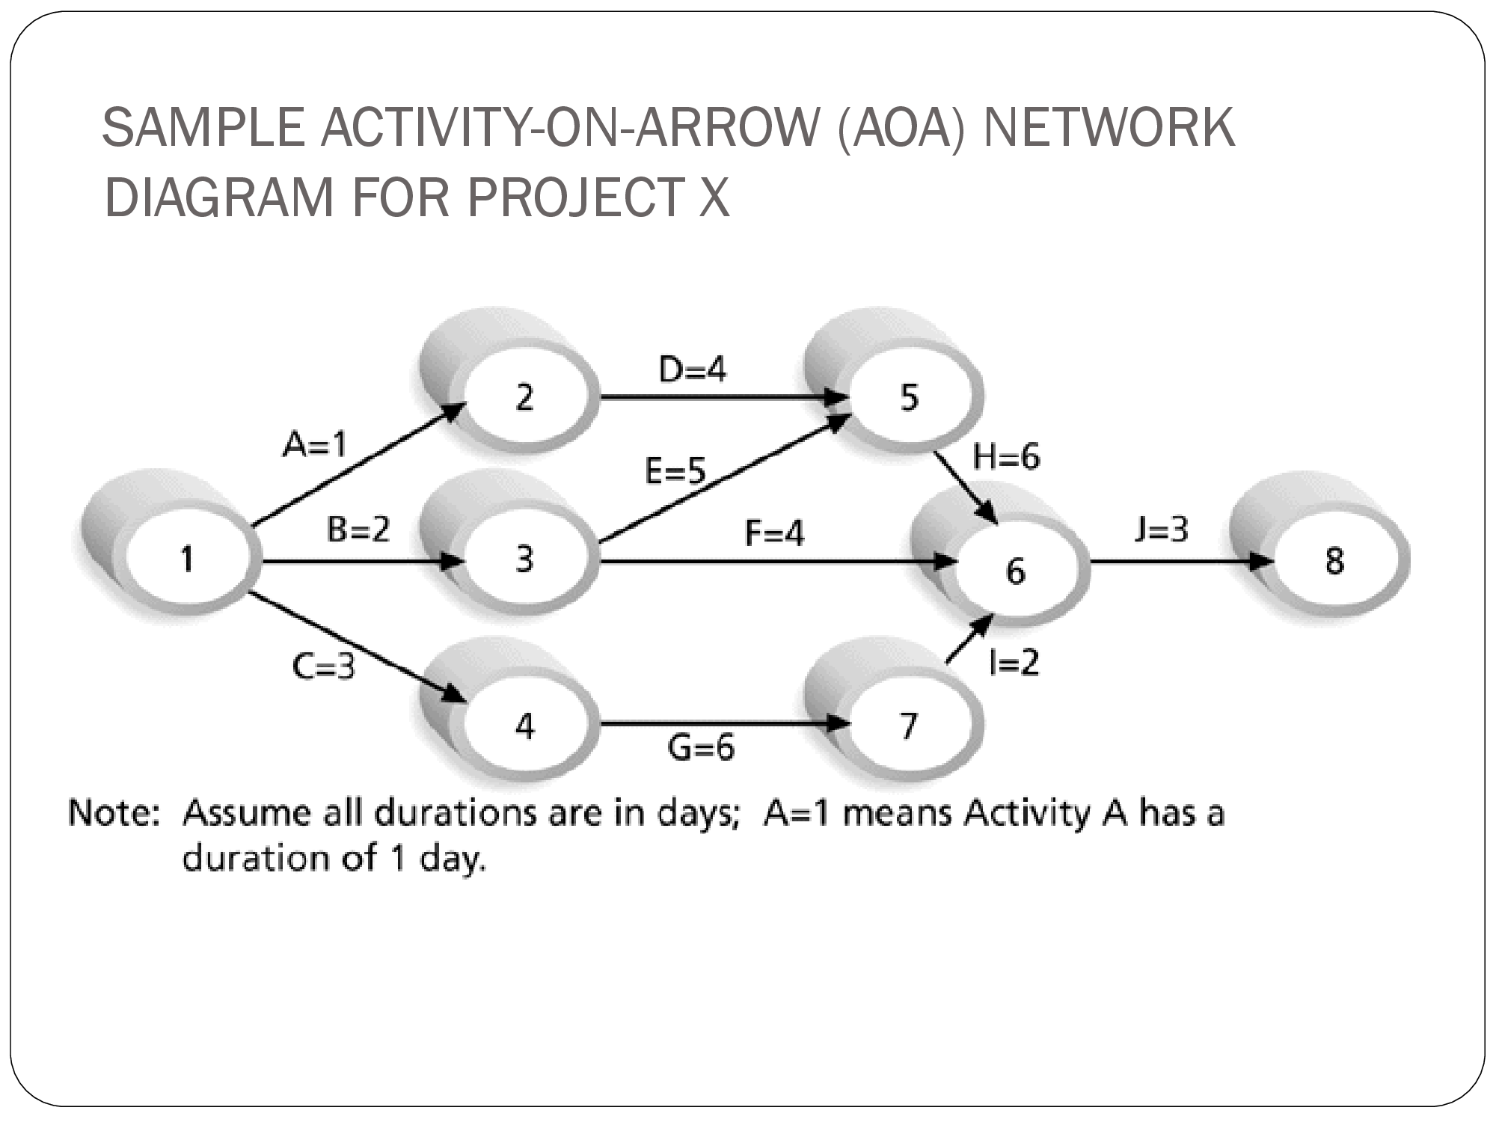

Slide 10
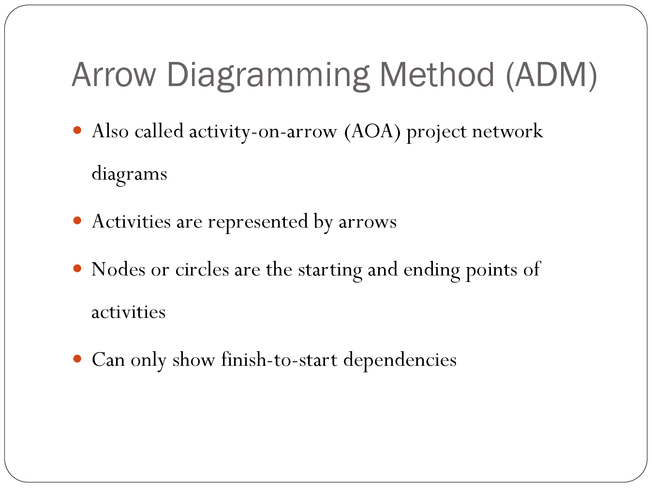

Slide 11
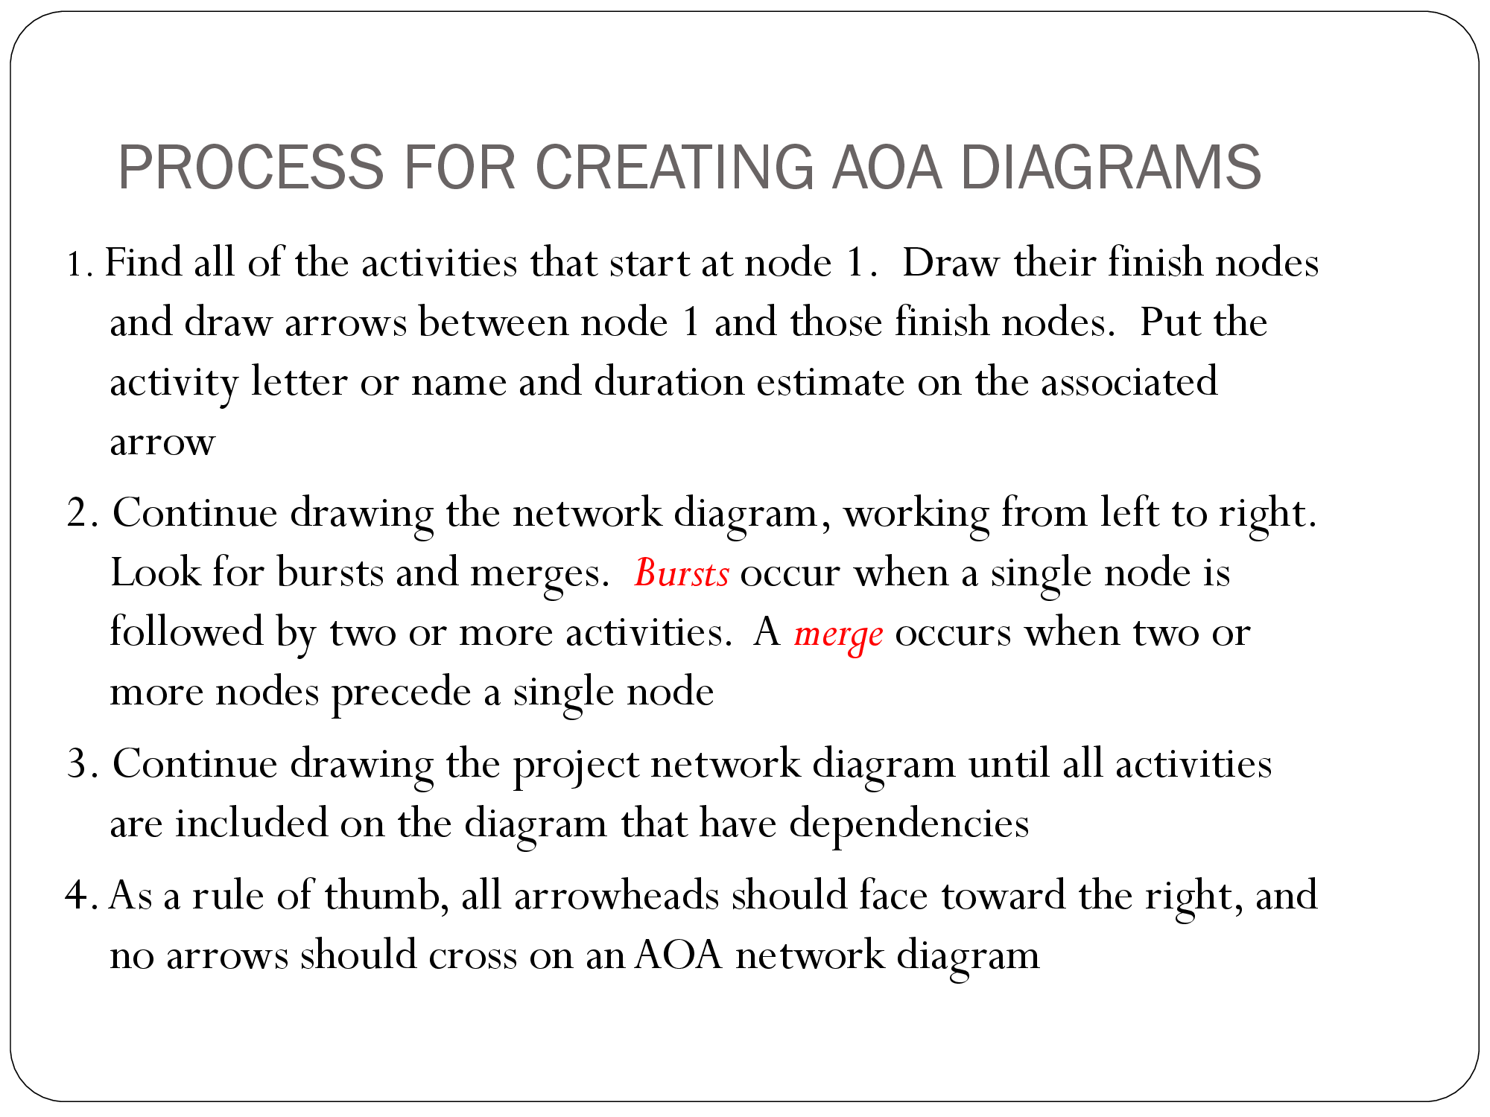

Slide 12
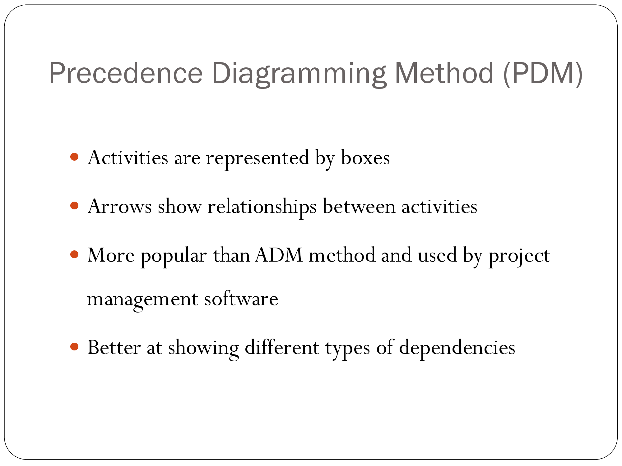

Slide 13
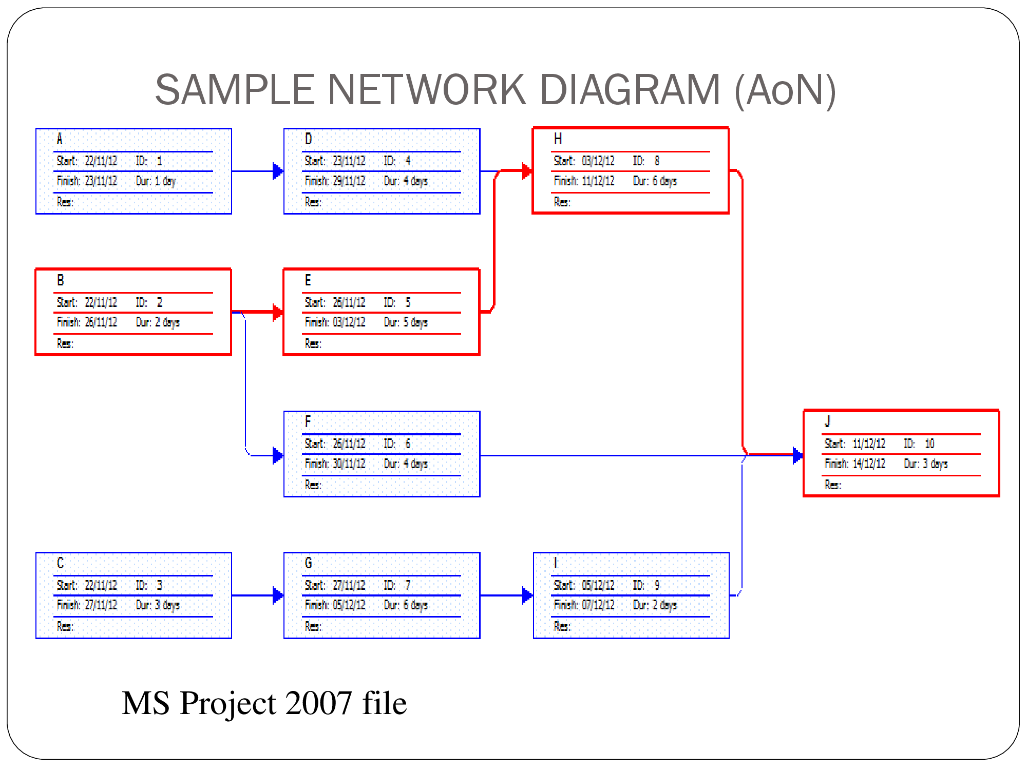

Slide 14
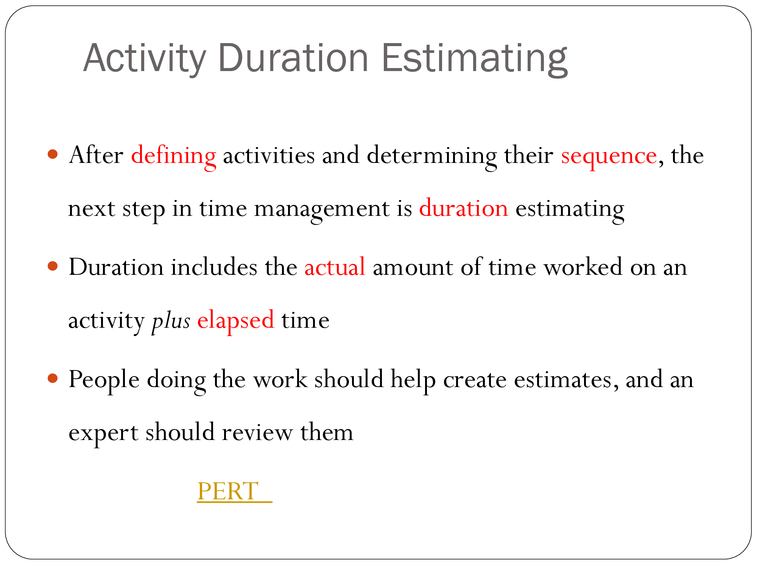
PERT
Notes:
Critical Path Method (CPM) Formula
Before we learn how to use the CPM formula, we need to understand some key CPM concepts.
Earliest start time (ES): This is simply the earliest time that a task can be started in your project. You cannot determine this without first knowing if there are any task dependencies
Latest start time (LS): This is the very last minute in which you can start a task before it threatens to delay your project timeline
Earliest finish time (EF): The earliest an activity can be completed, based on its duration and its earliest start time
Latest finish time (LF): The latest an activity can be completed, based on its duration and its latest start time
Float: Also known as slack, float is a term that describes how long you can delay a task before it impacts its task sequence and the project schedule. The tasks on the critical path have zero float because they can’t be delayed

Slide 15
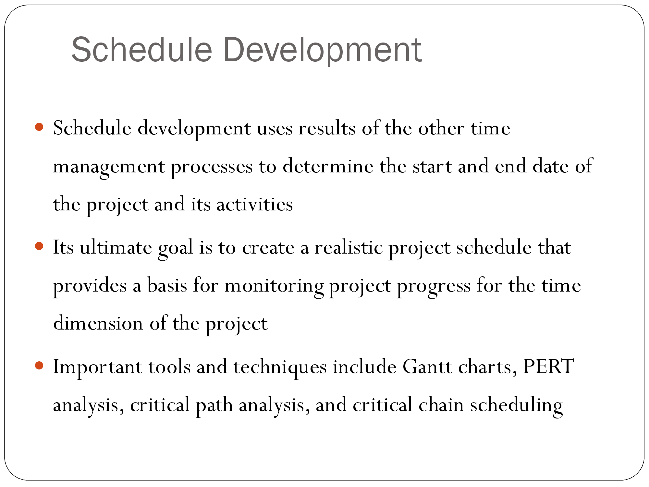

Slide 16
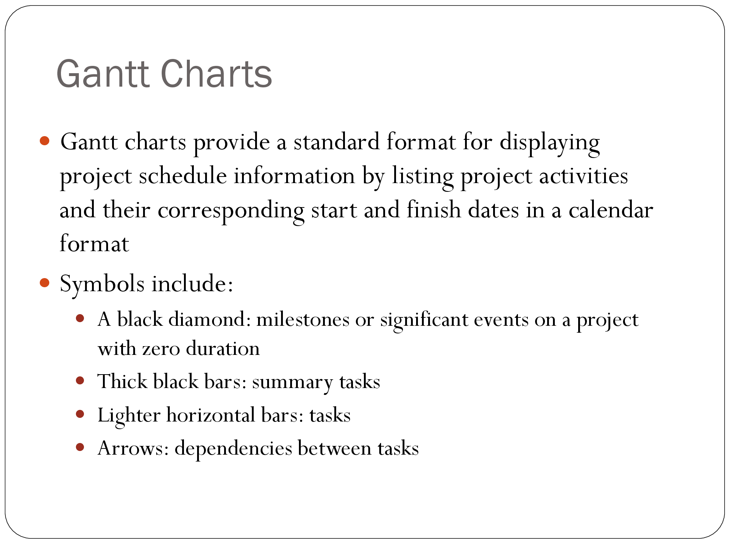

Slide 17
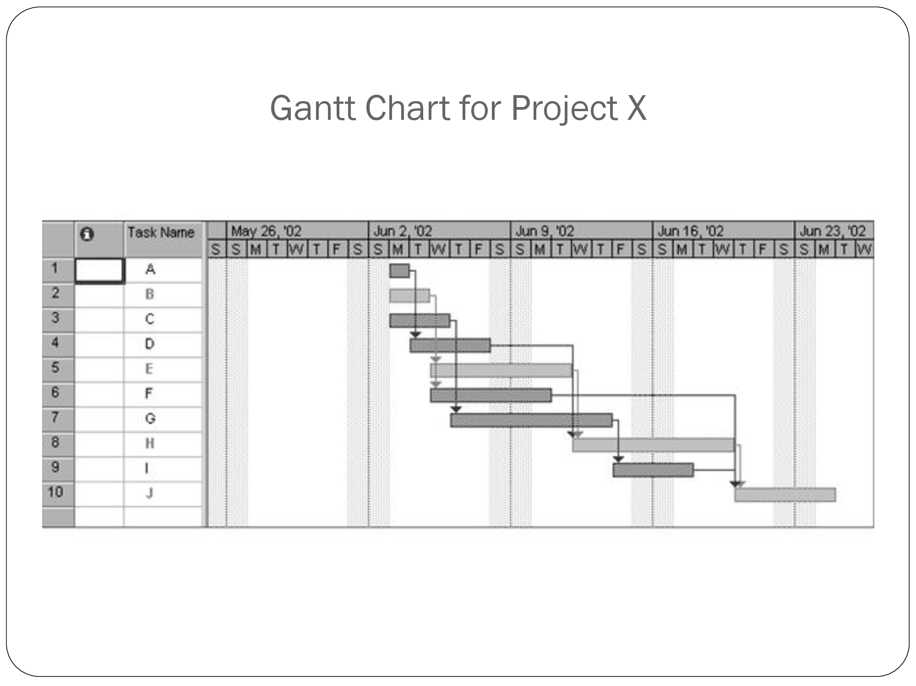

Slide 18
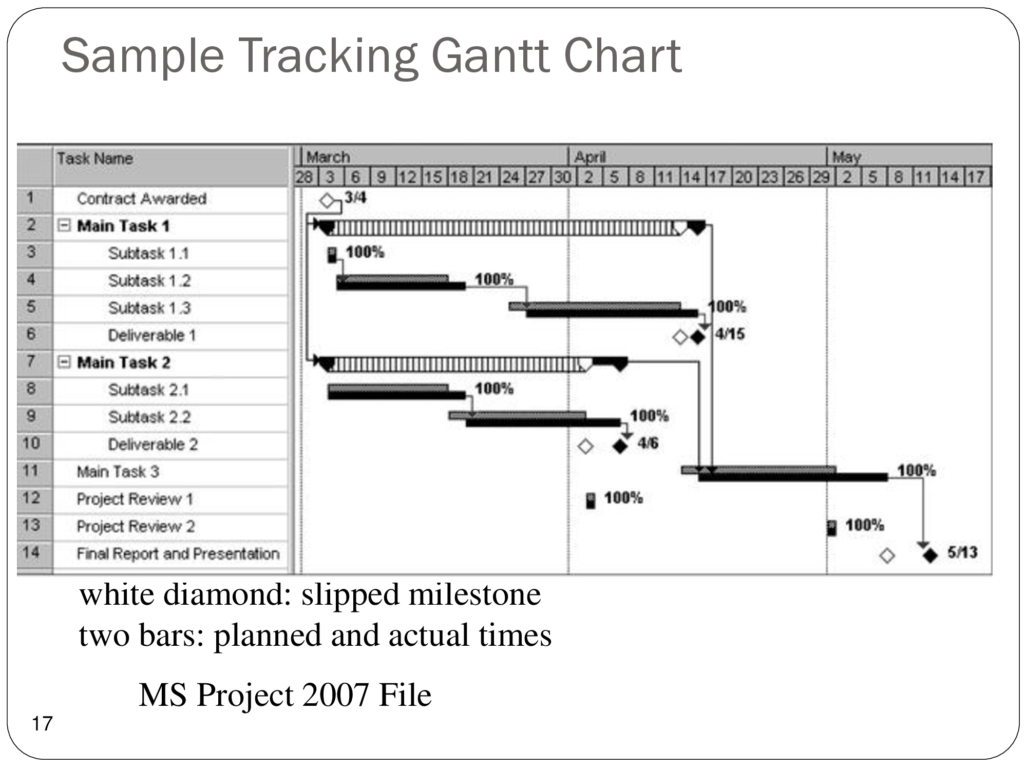

Slide 19
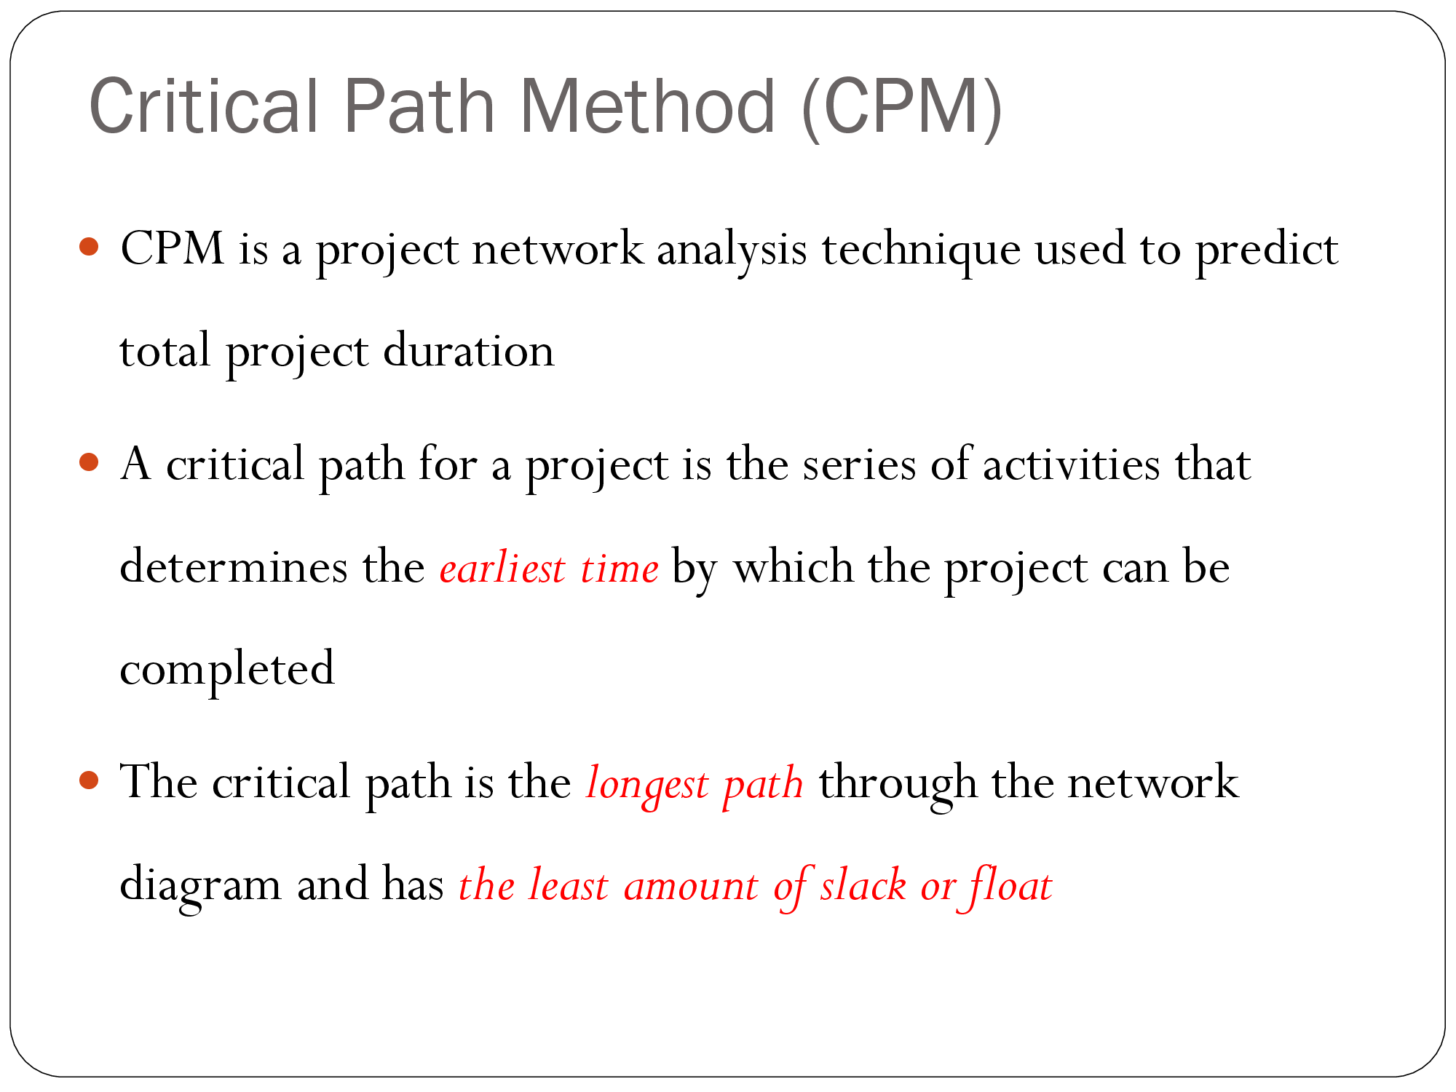

Slide 20
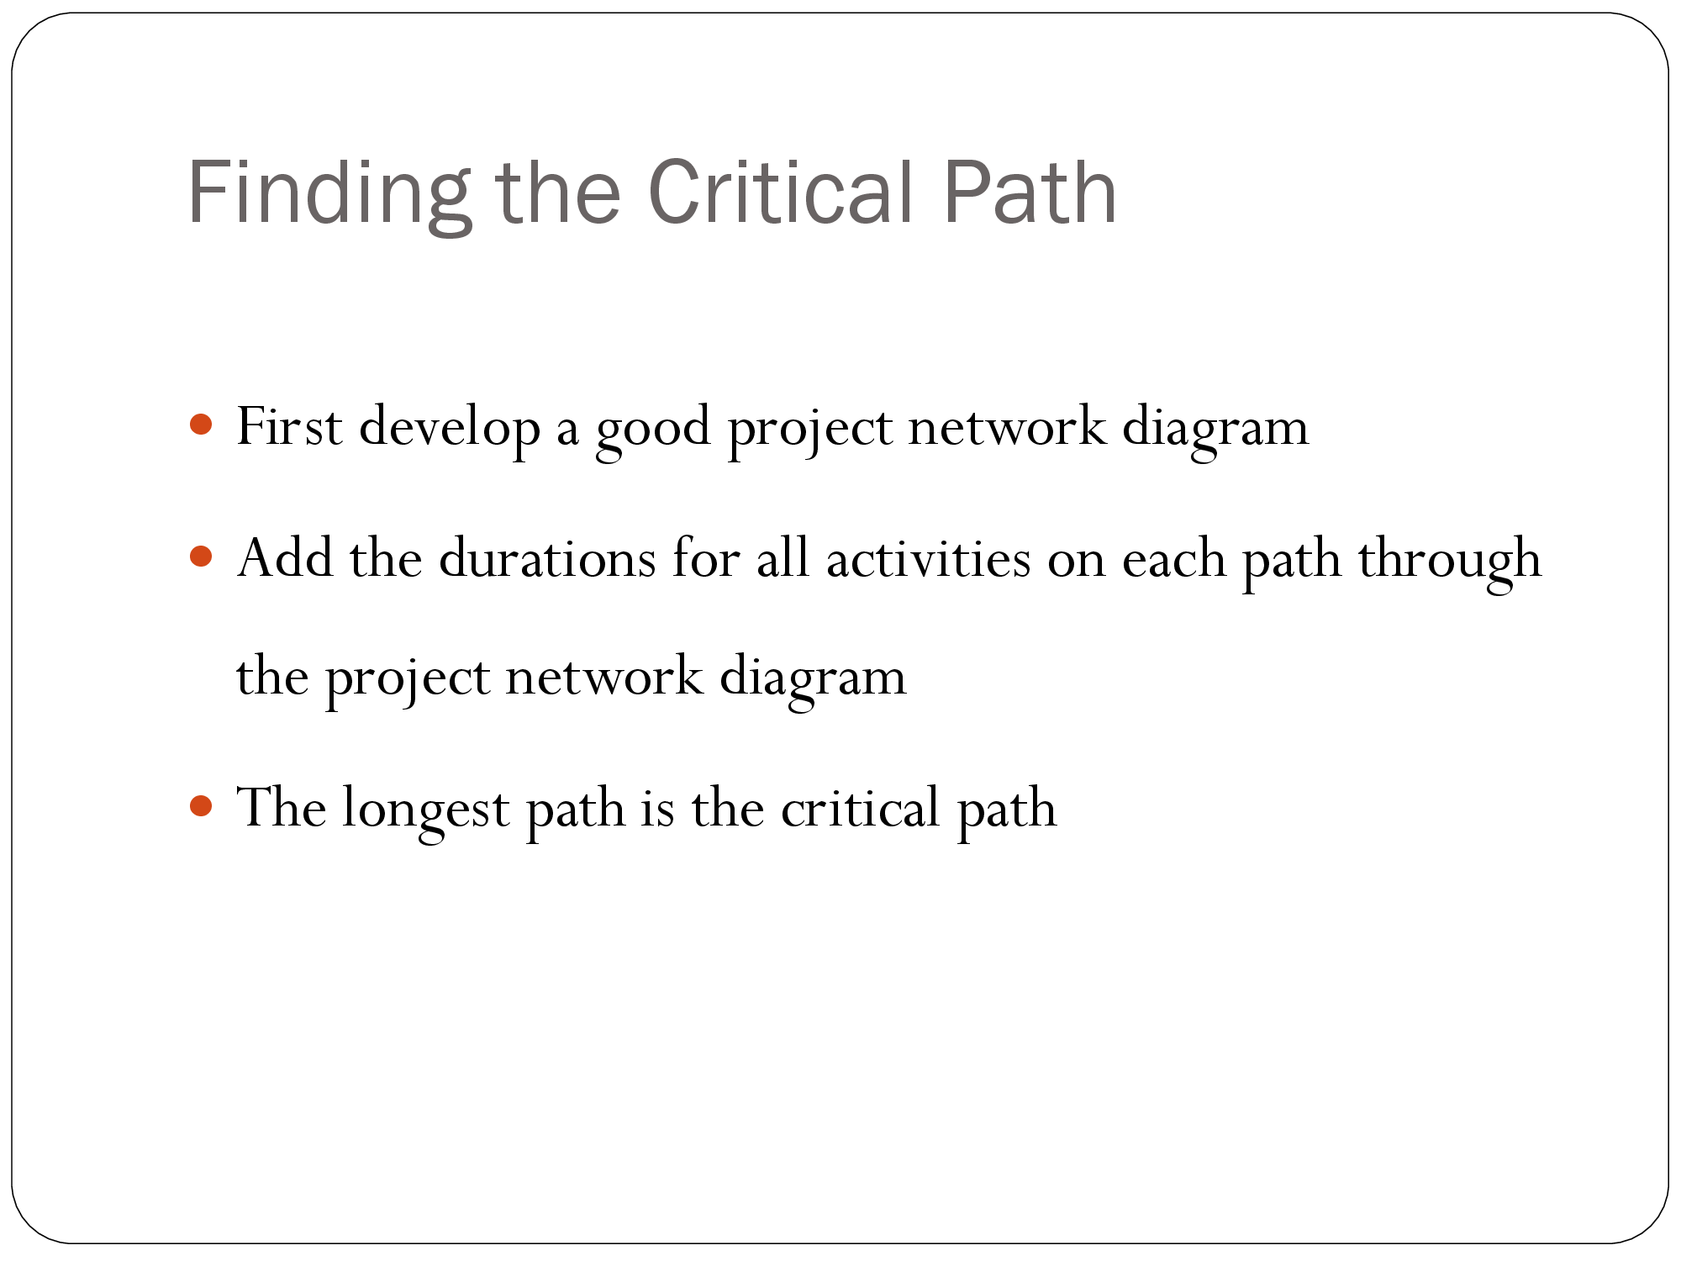

Slide 21
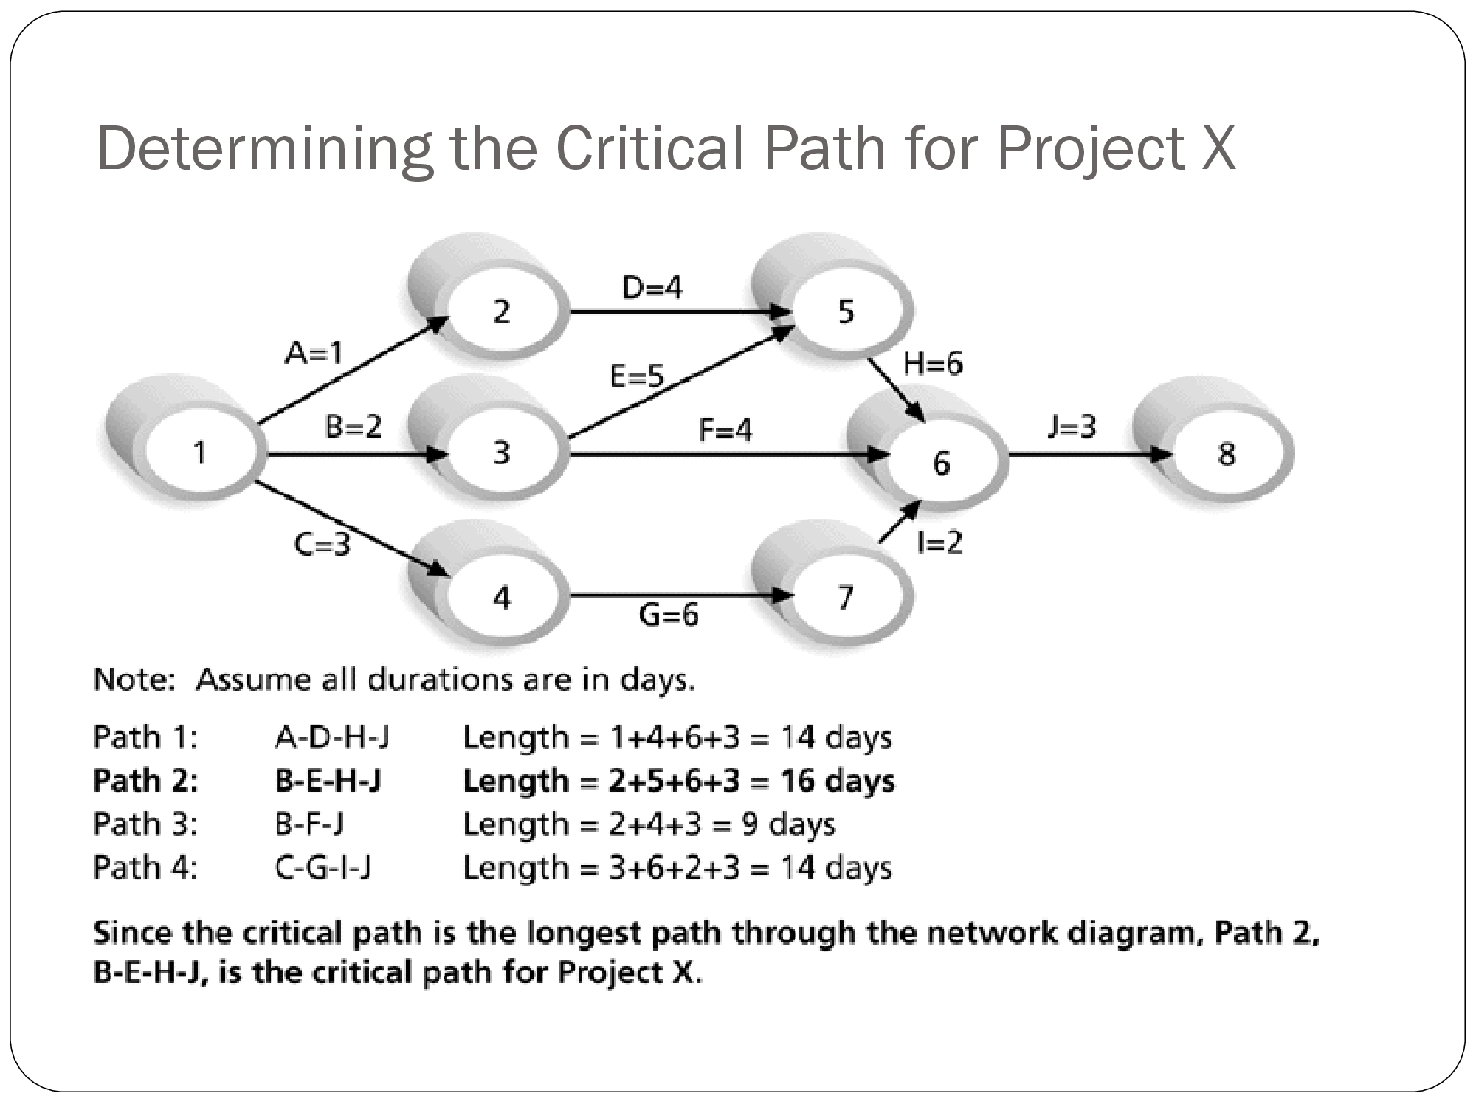

Slide 22
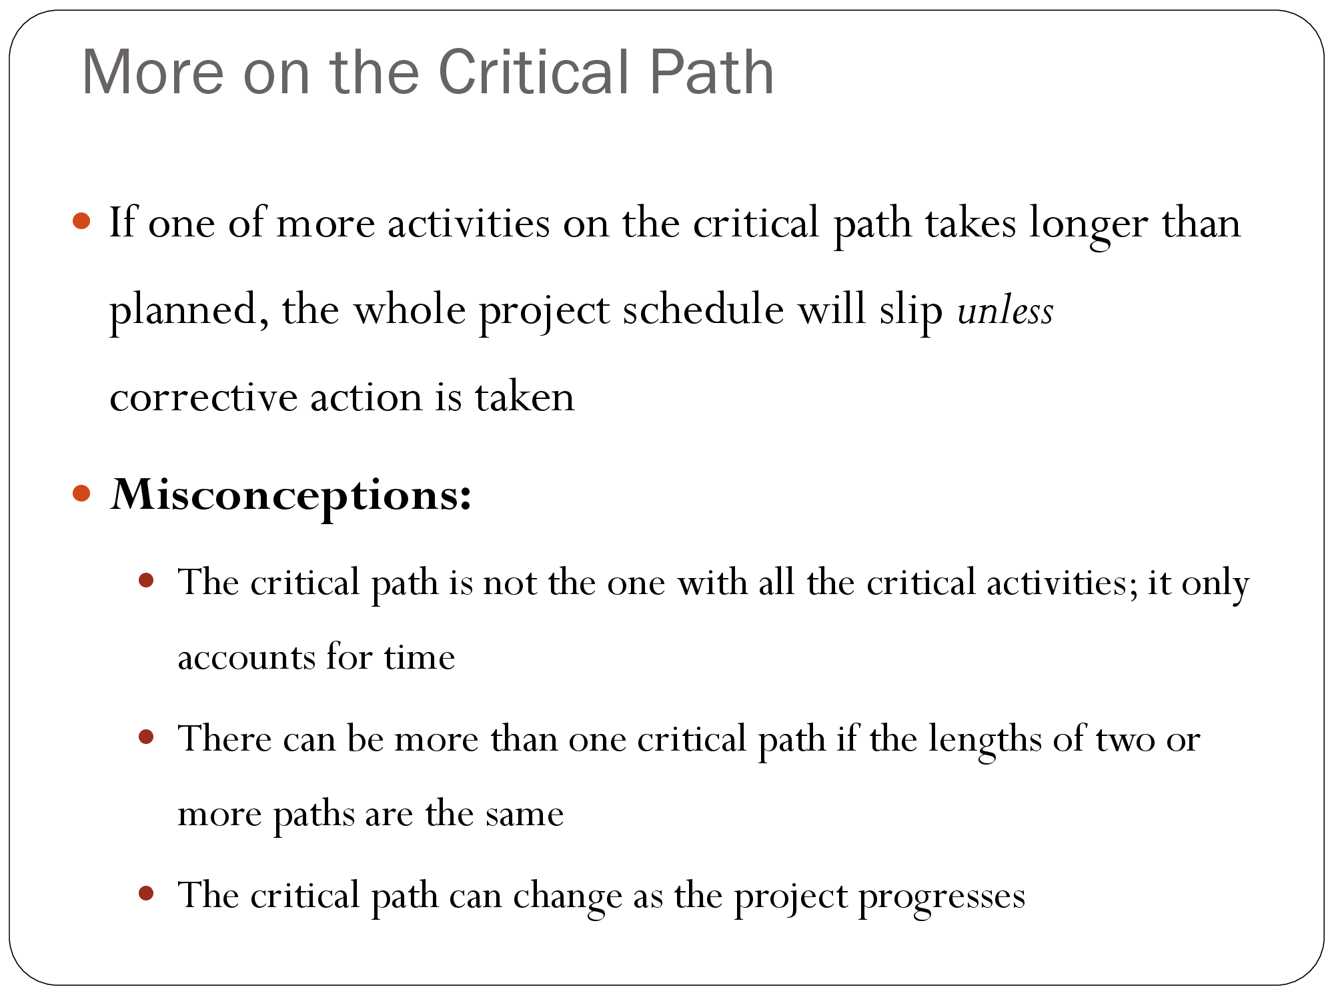

Slide 23
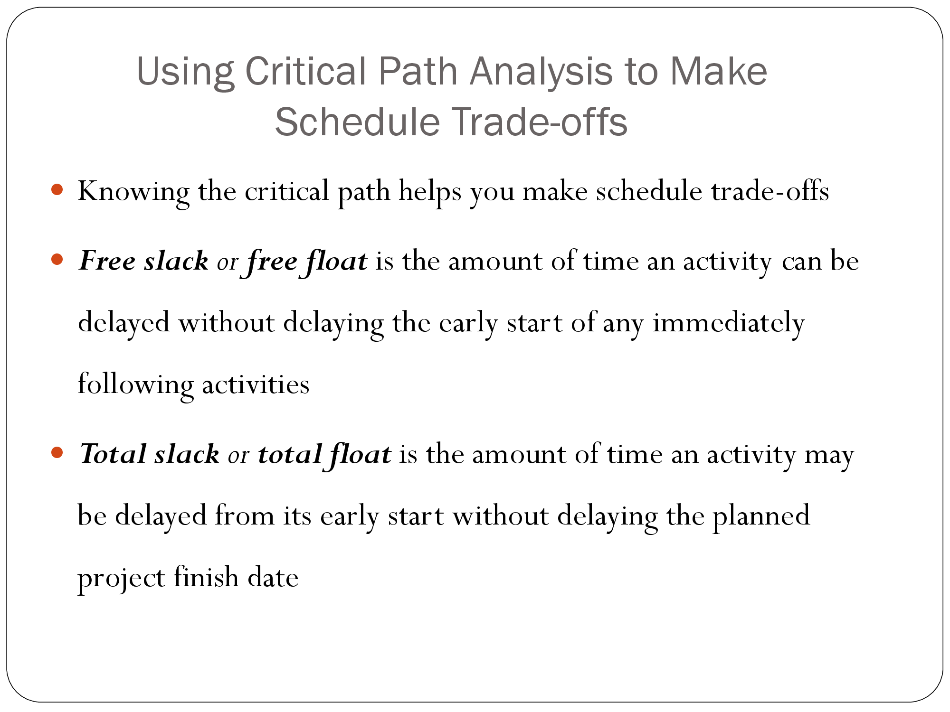

Slide 24
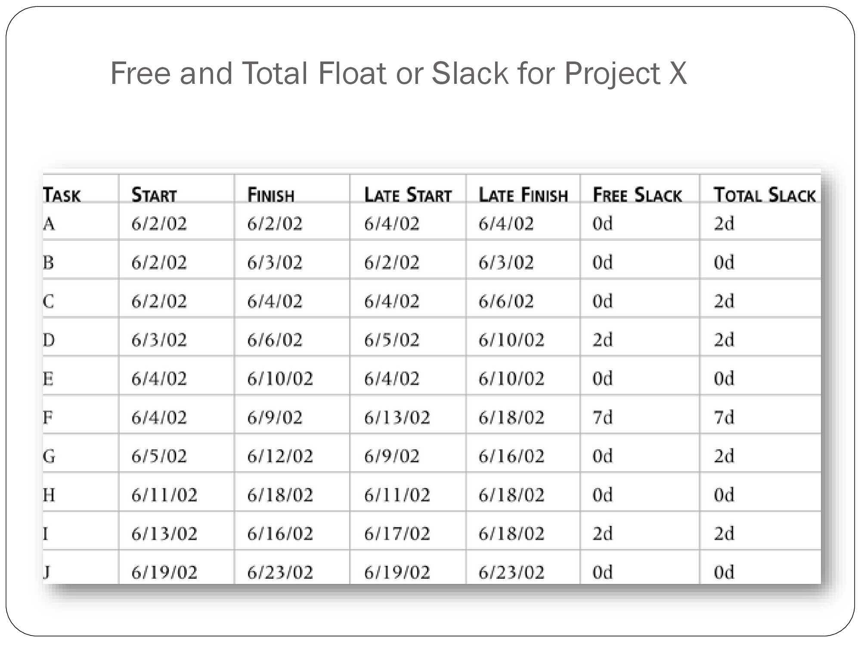

Slide 25
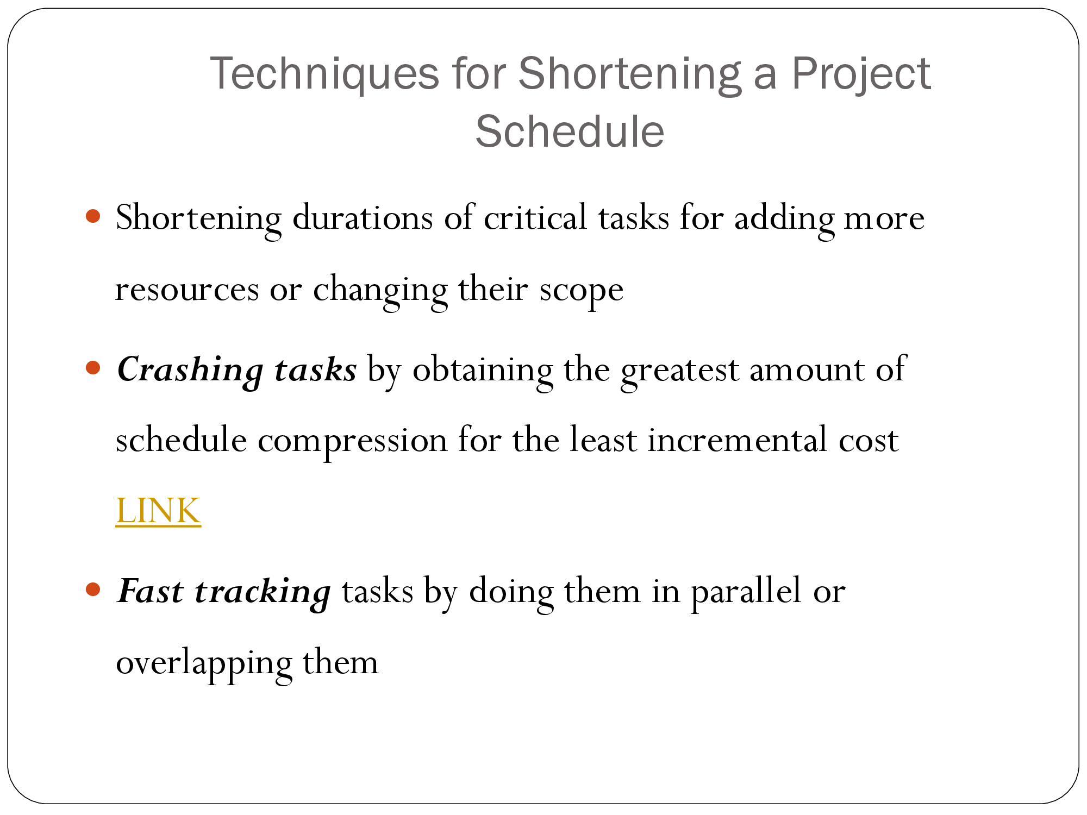
CRASHING

Slide 26
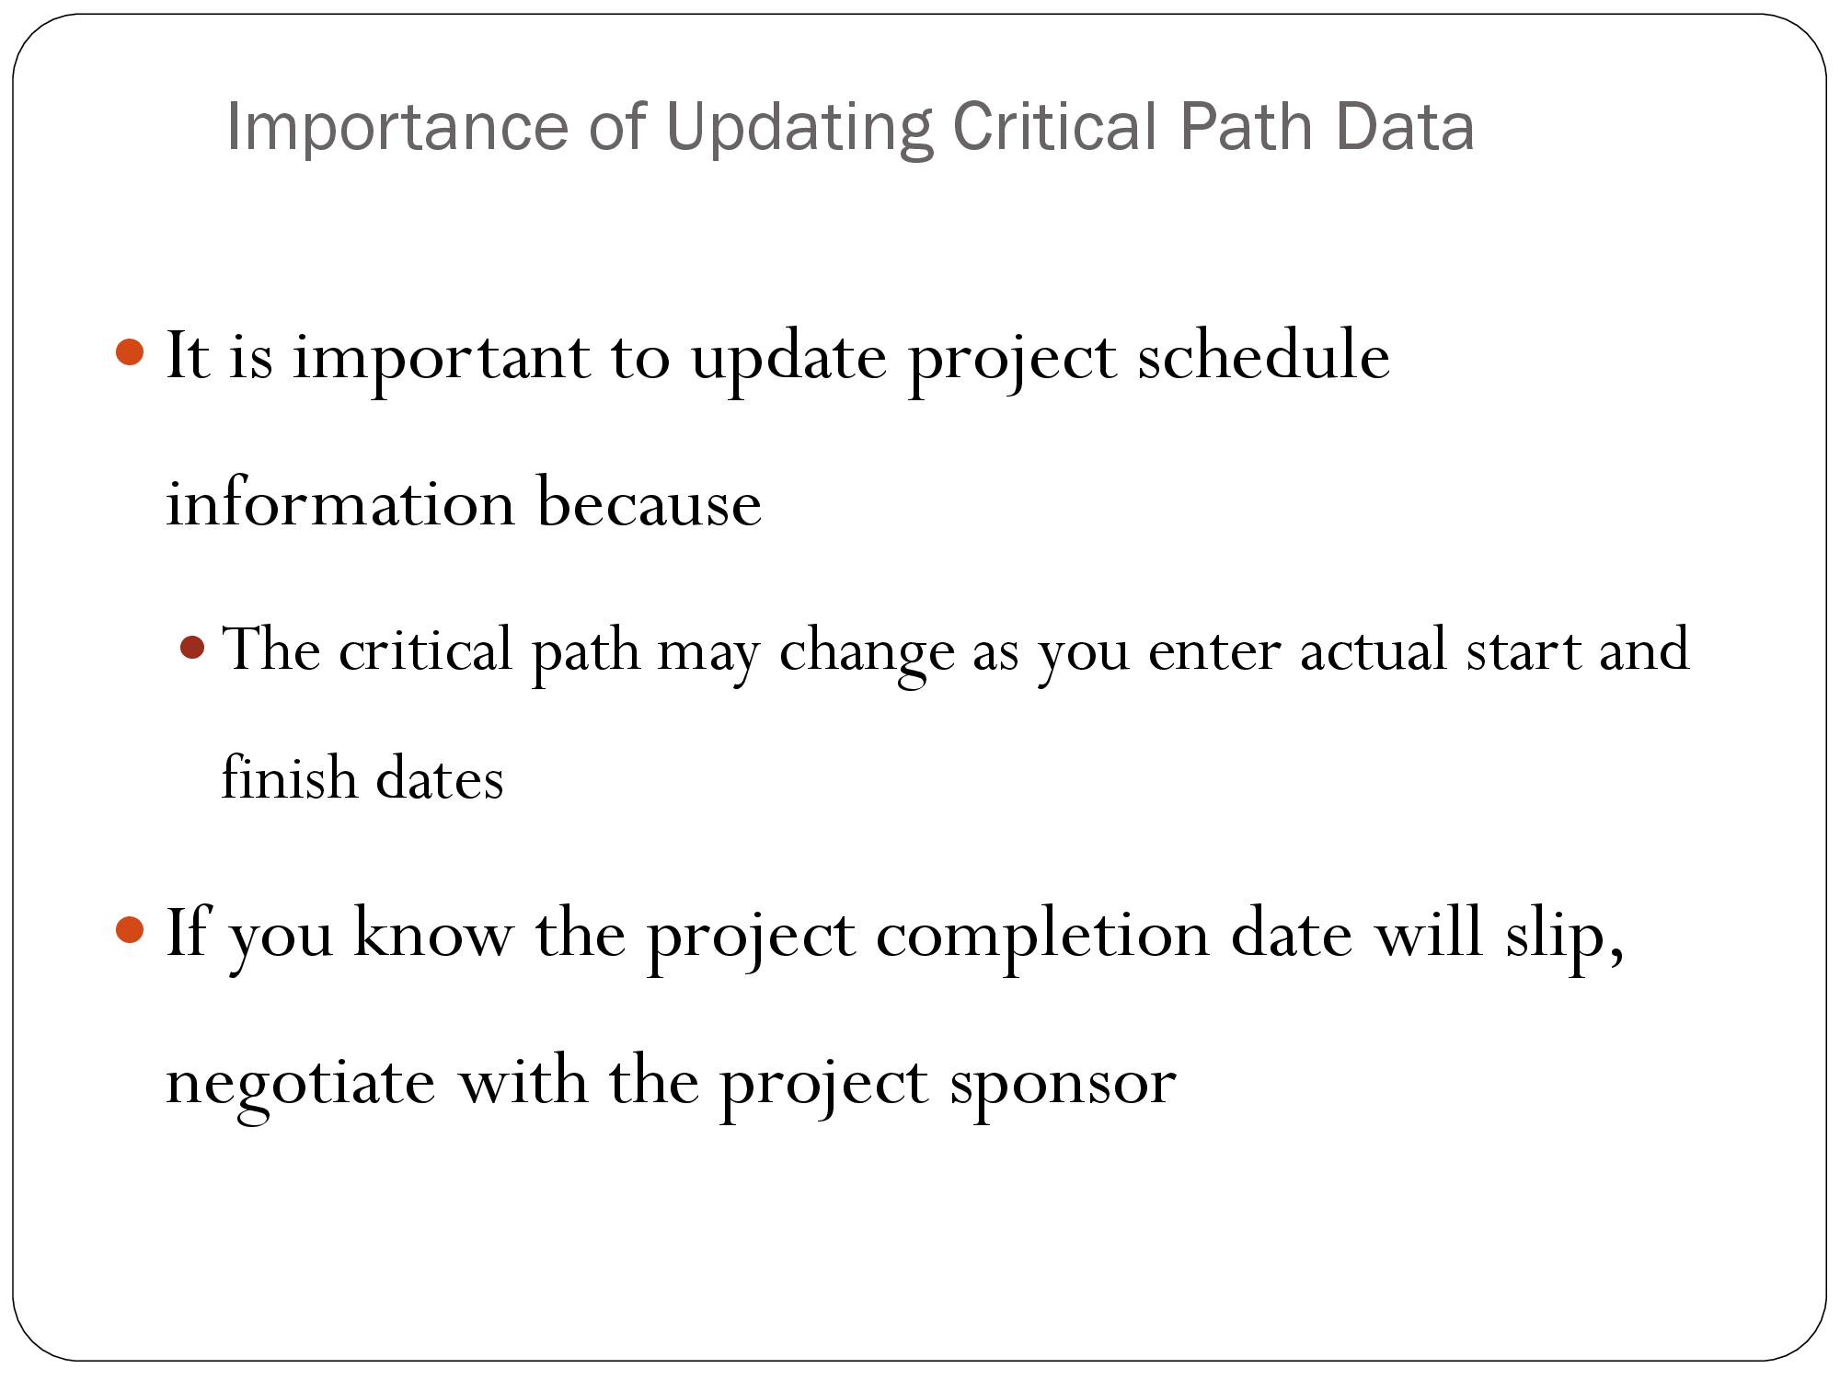

Slide 27
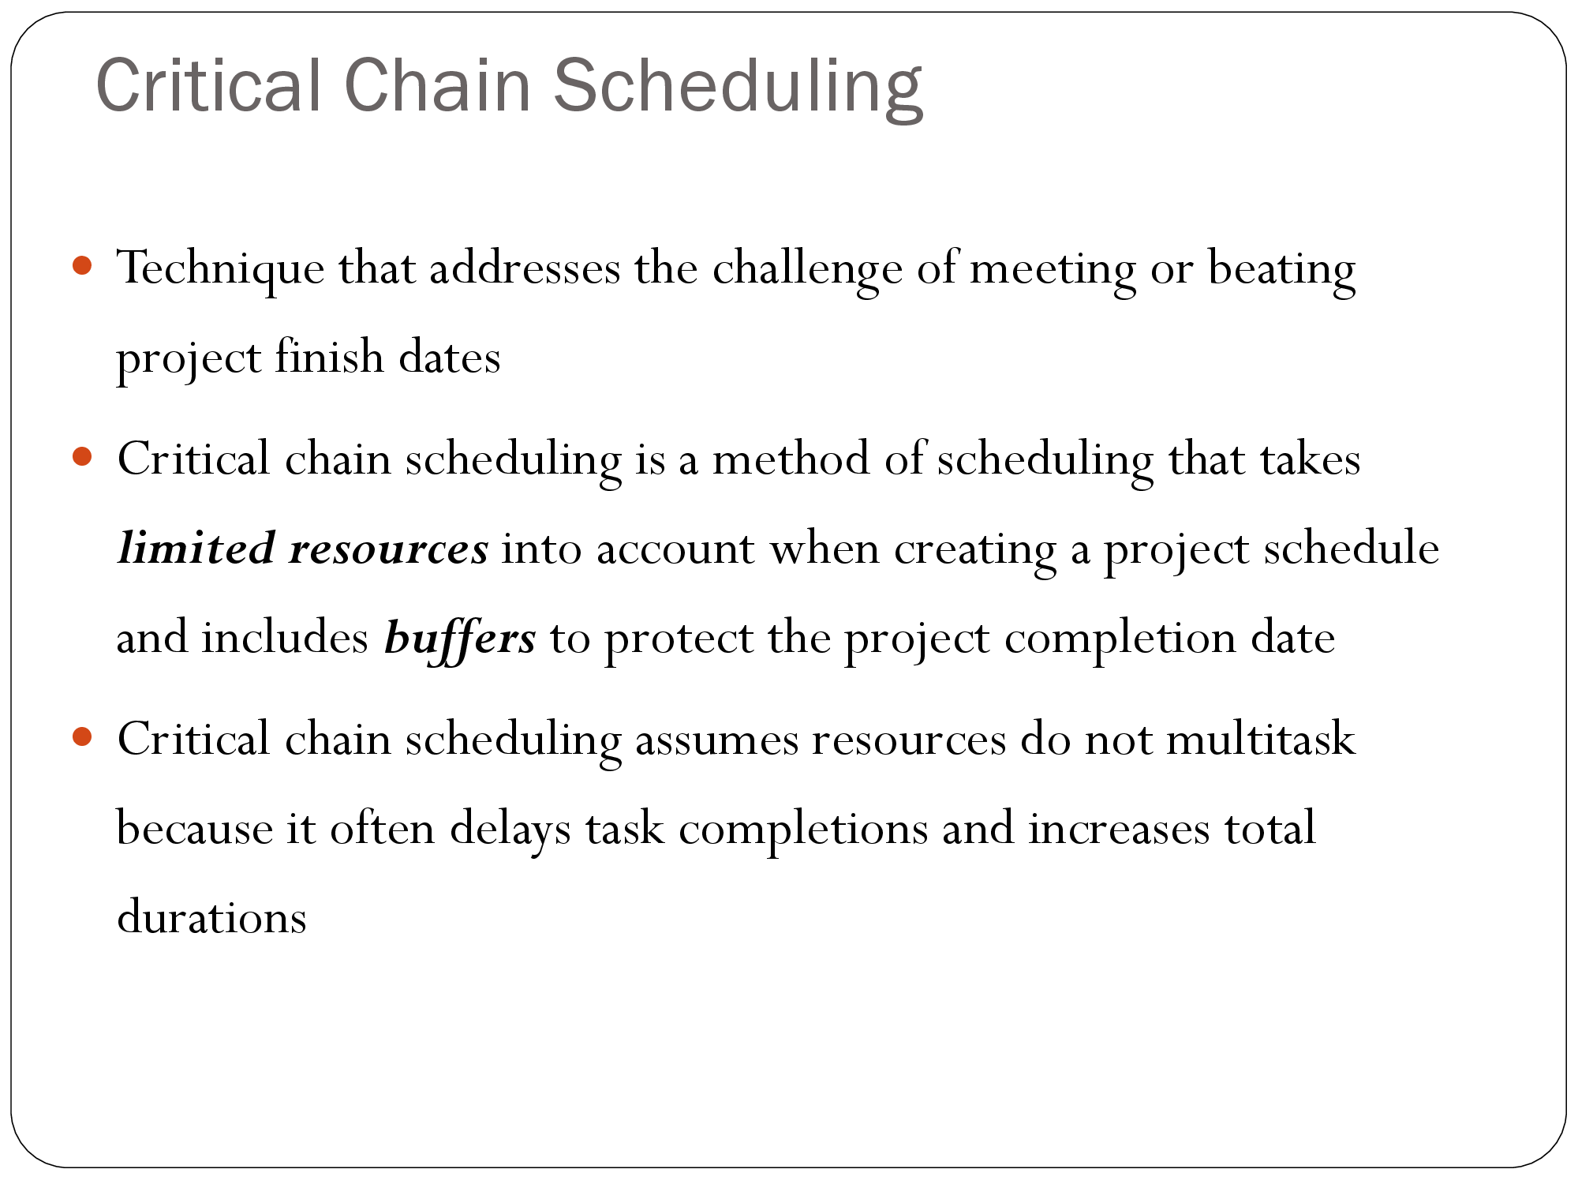

Slide 28
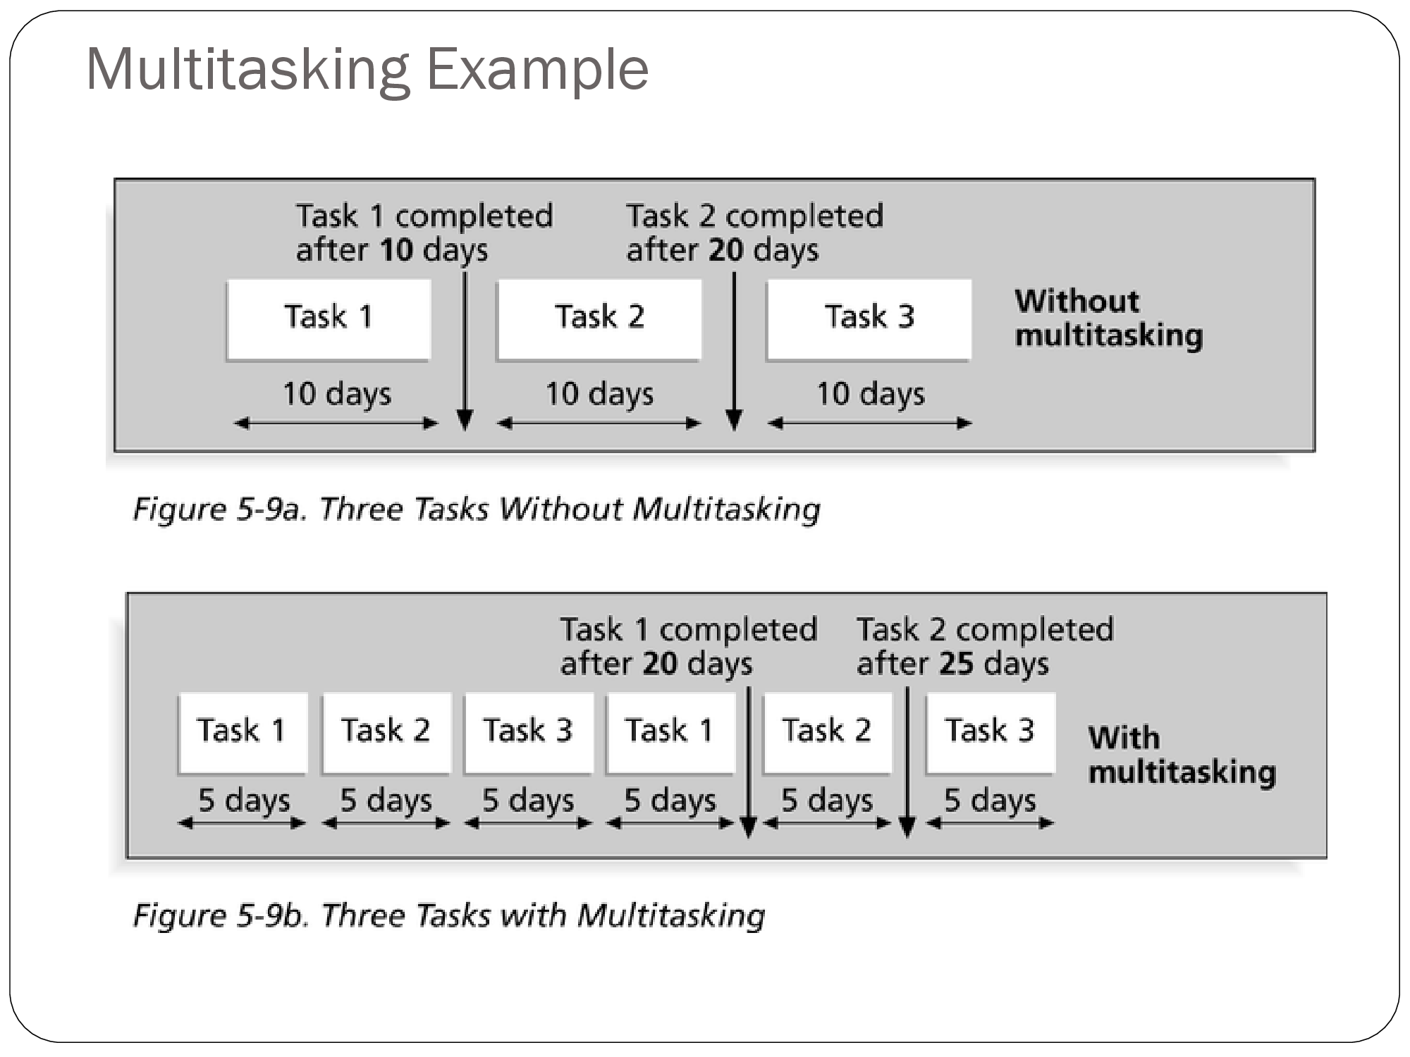

Slide 29
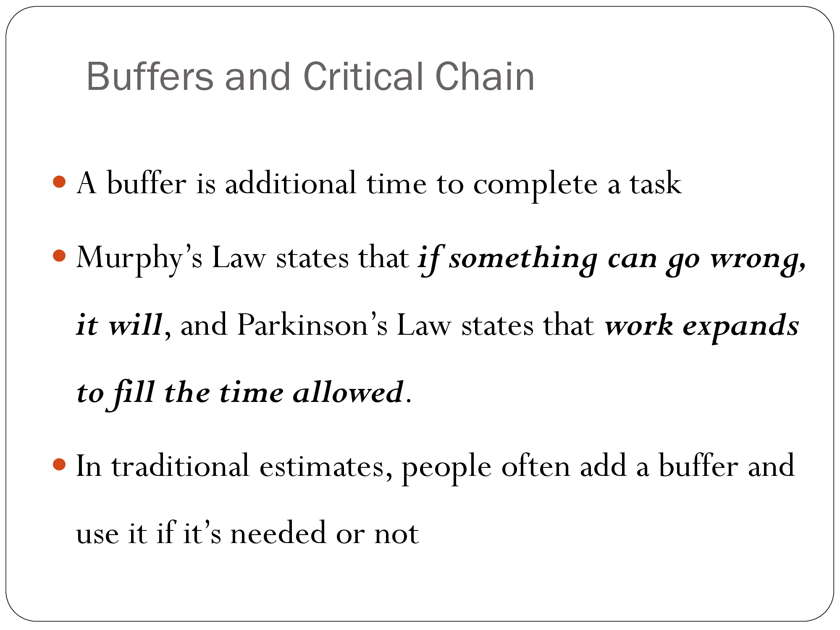

Slide 30
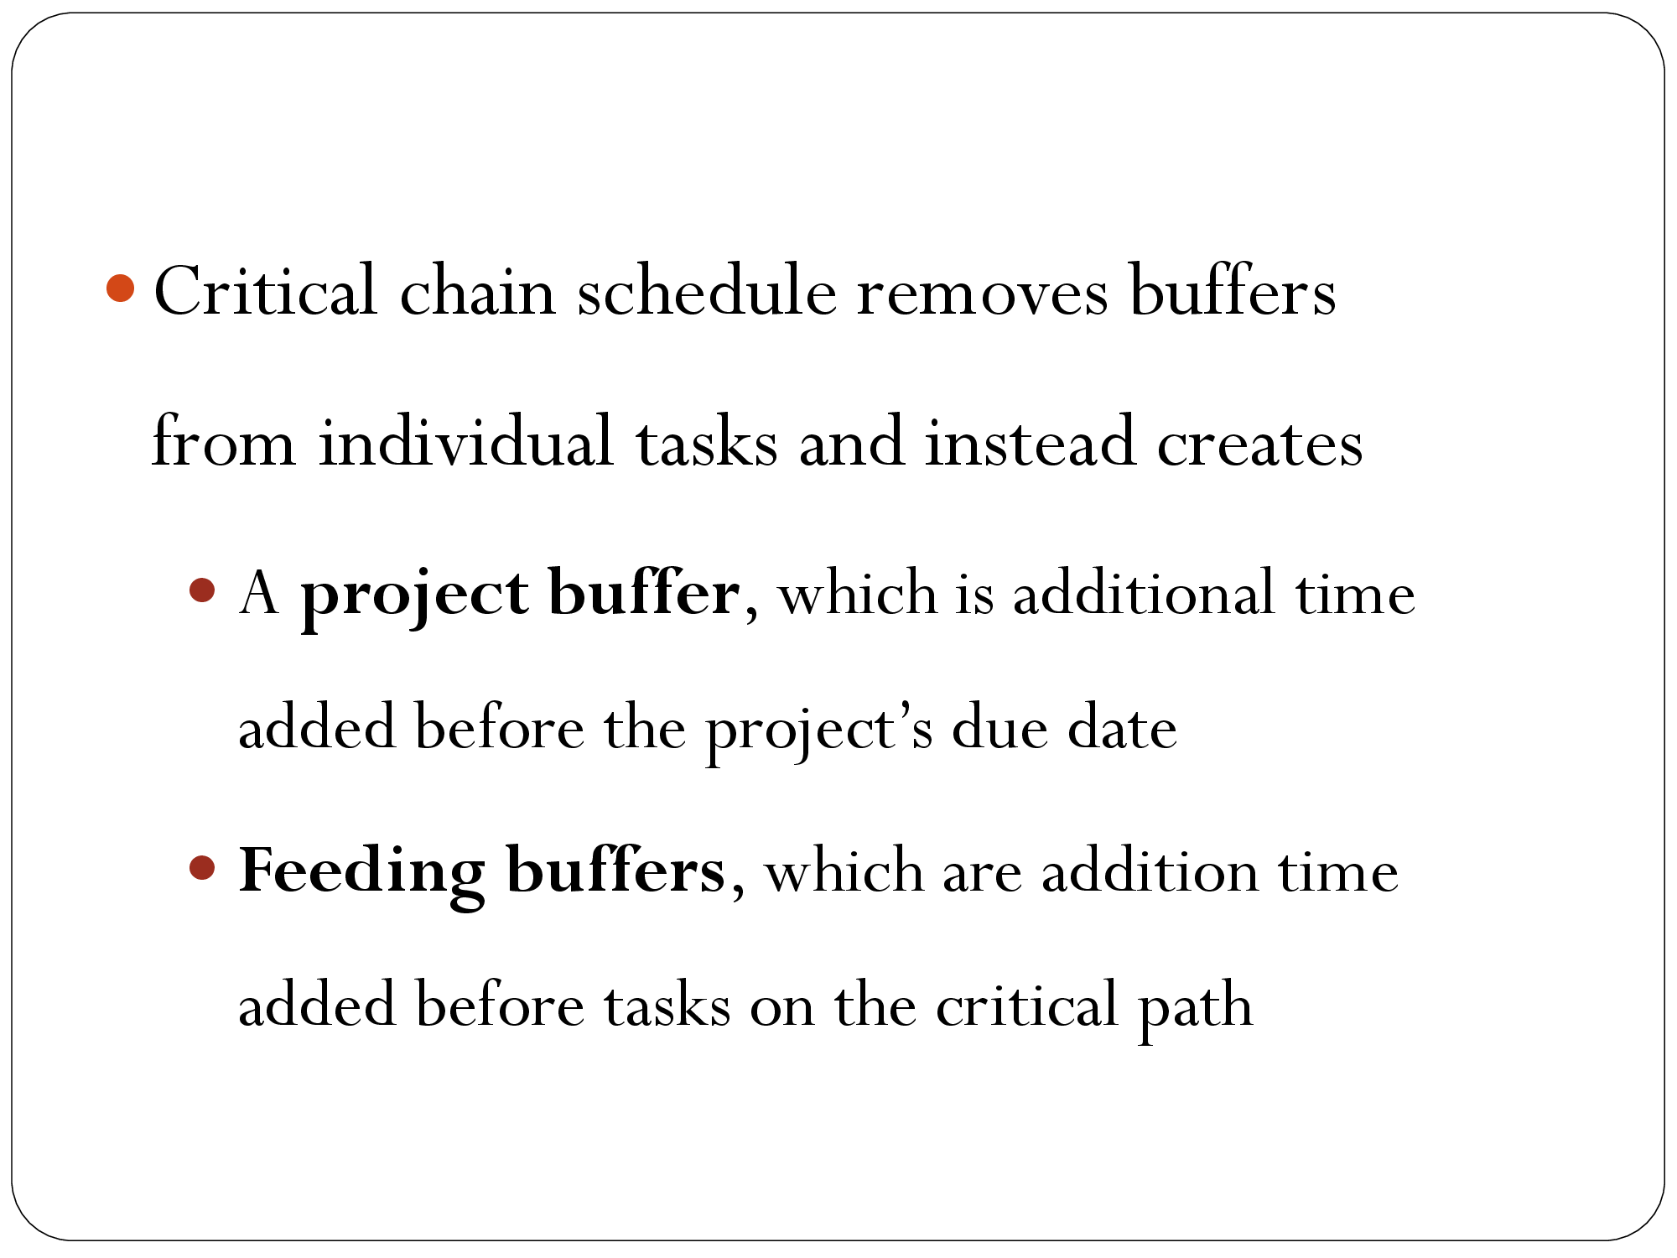

Slide 31
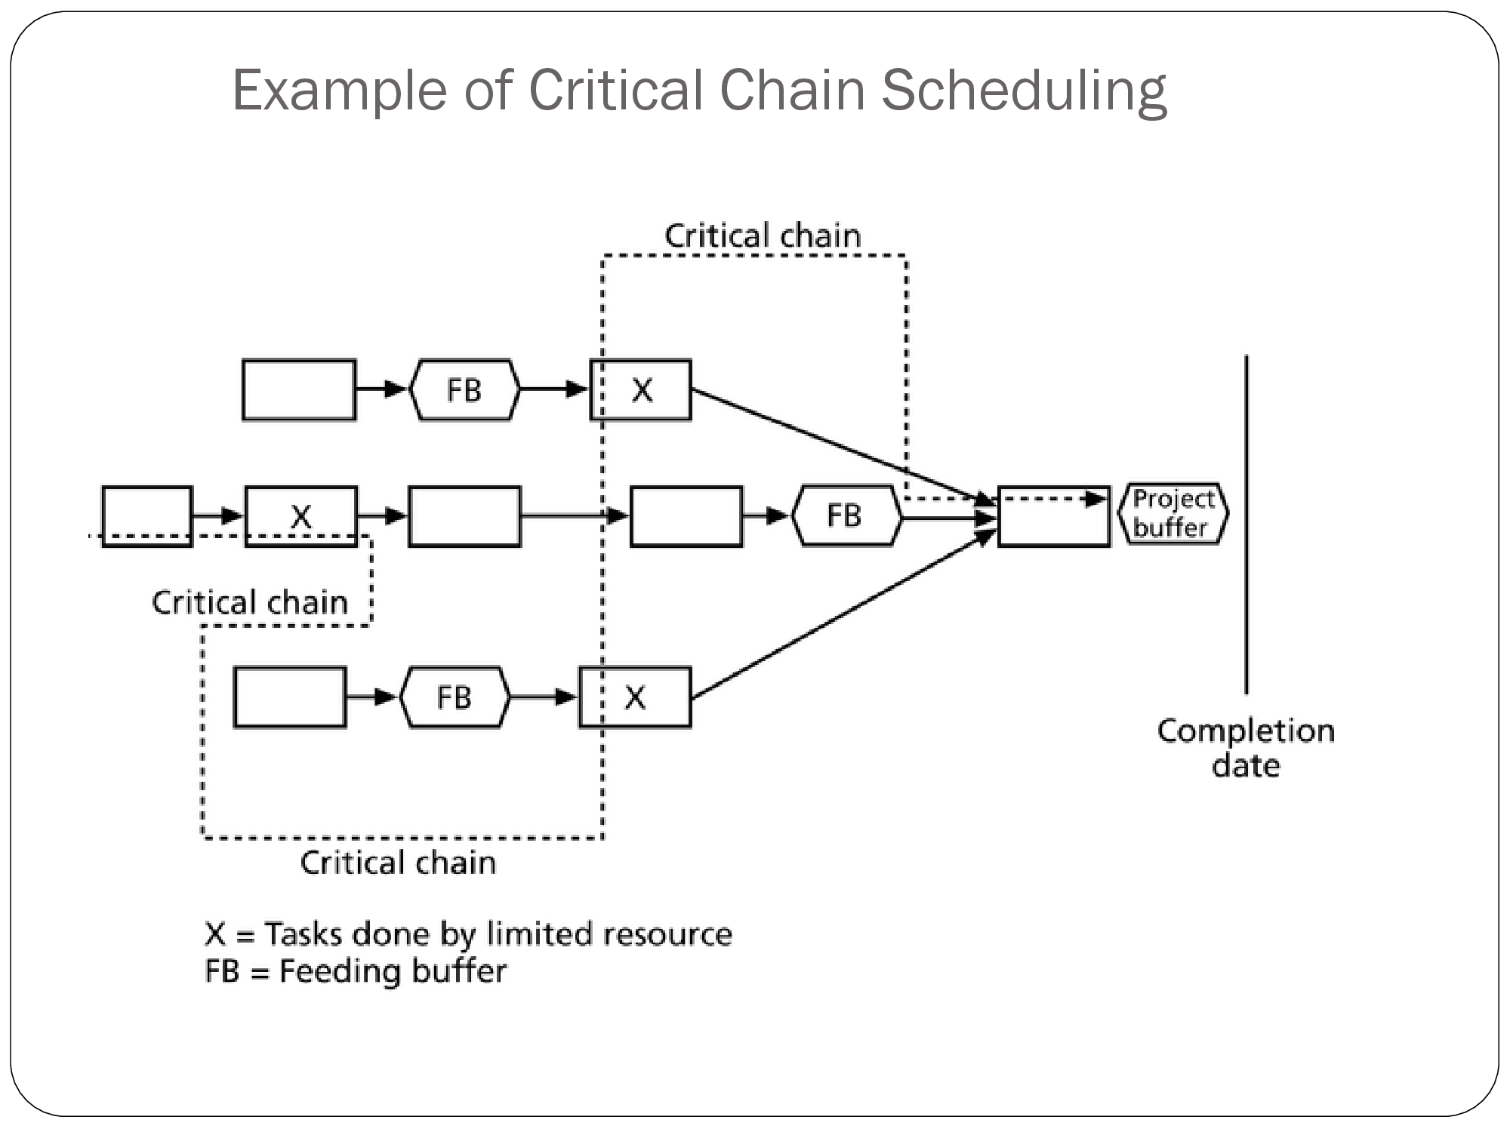

Slide 32
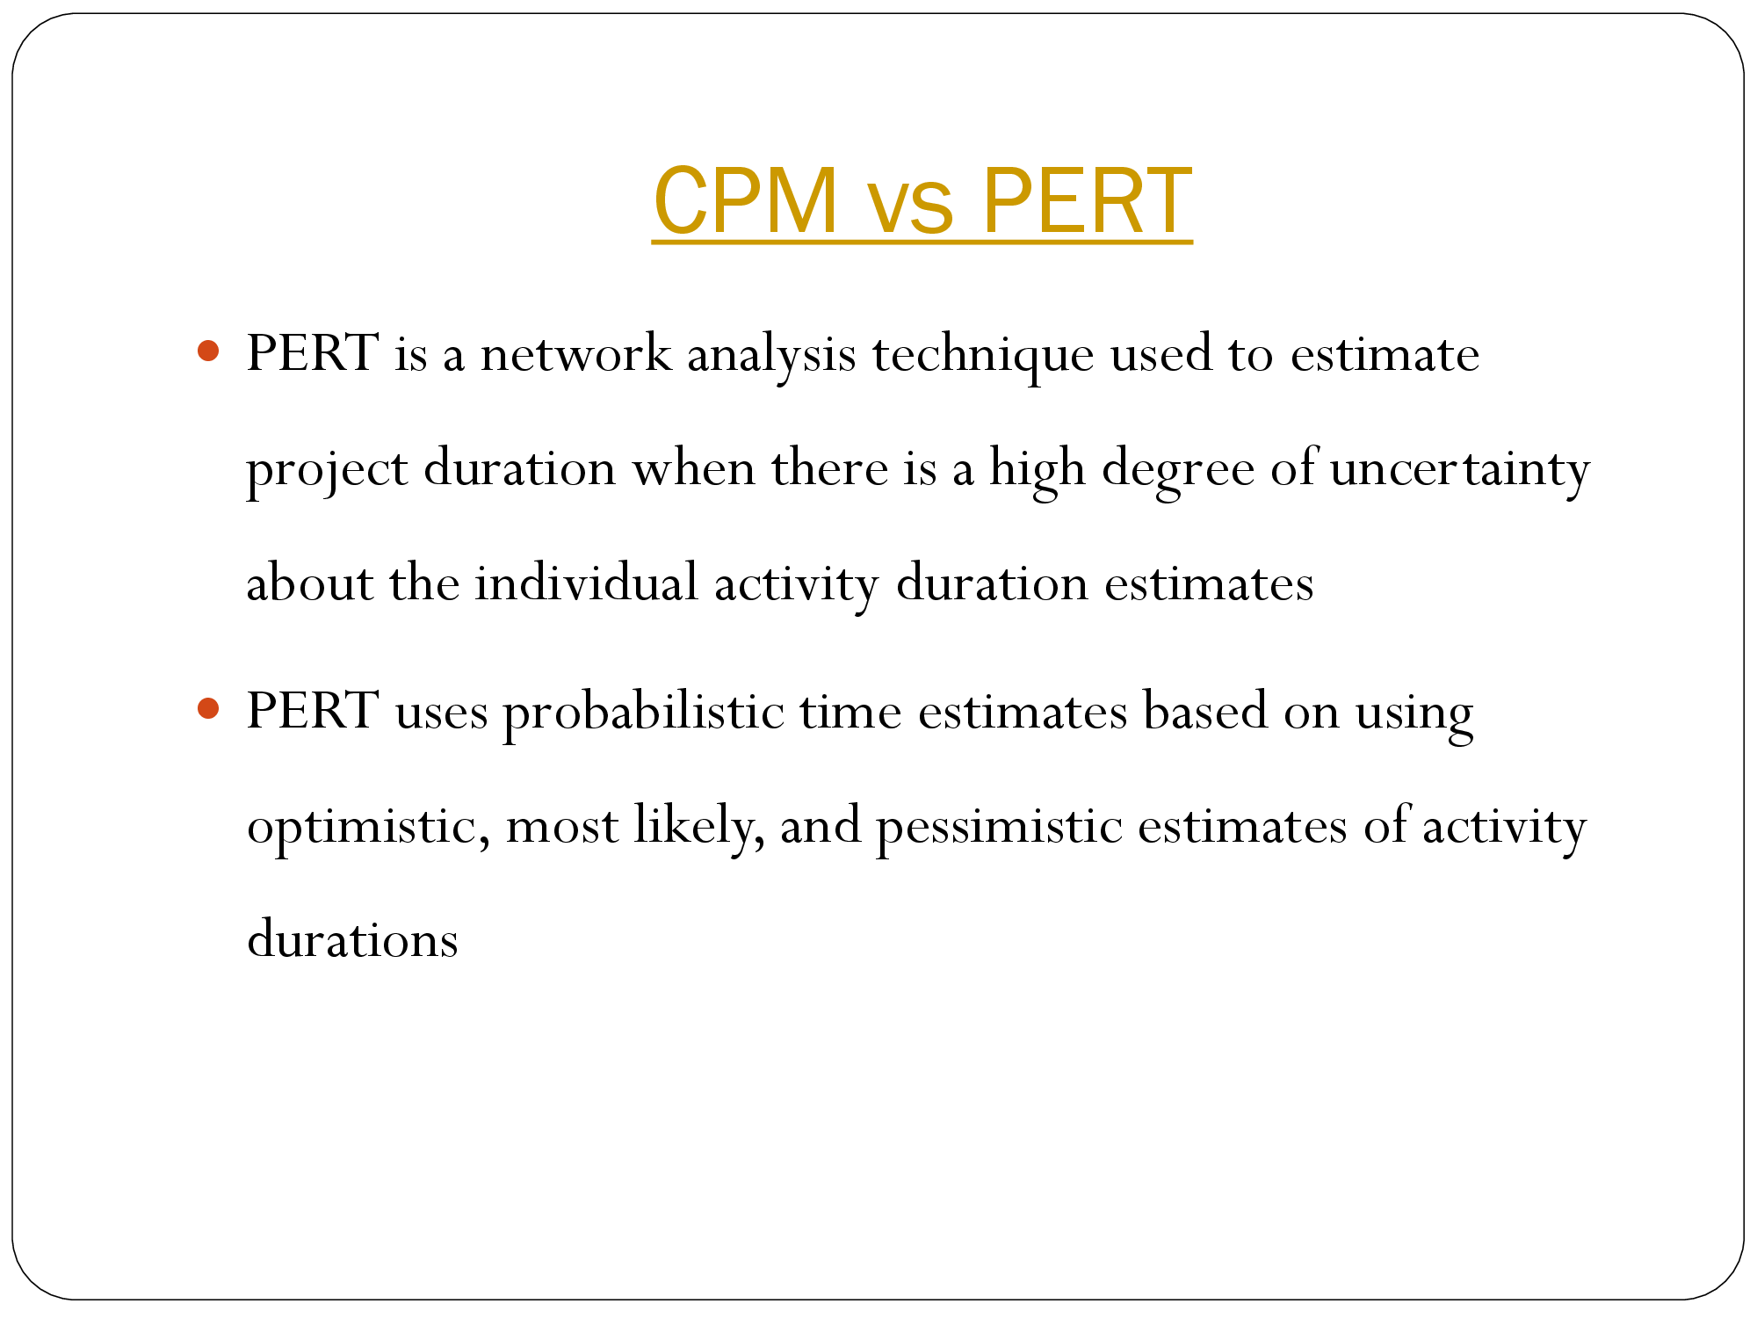

Slide 33
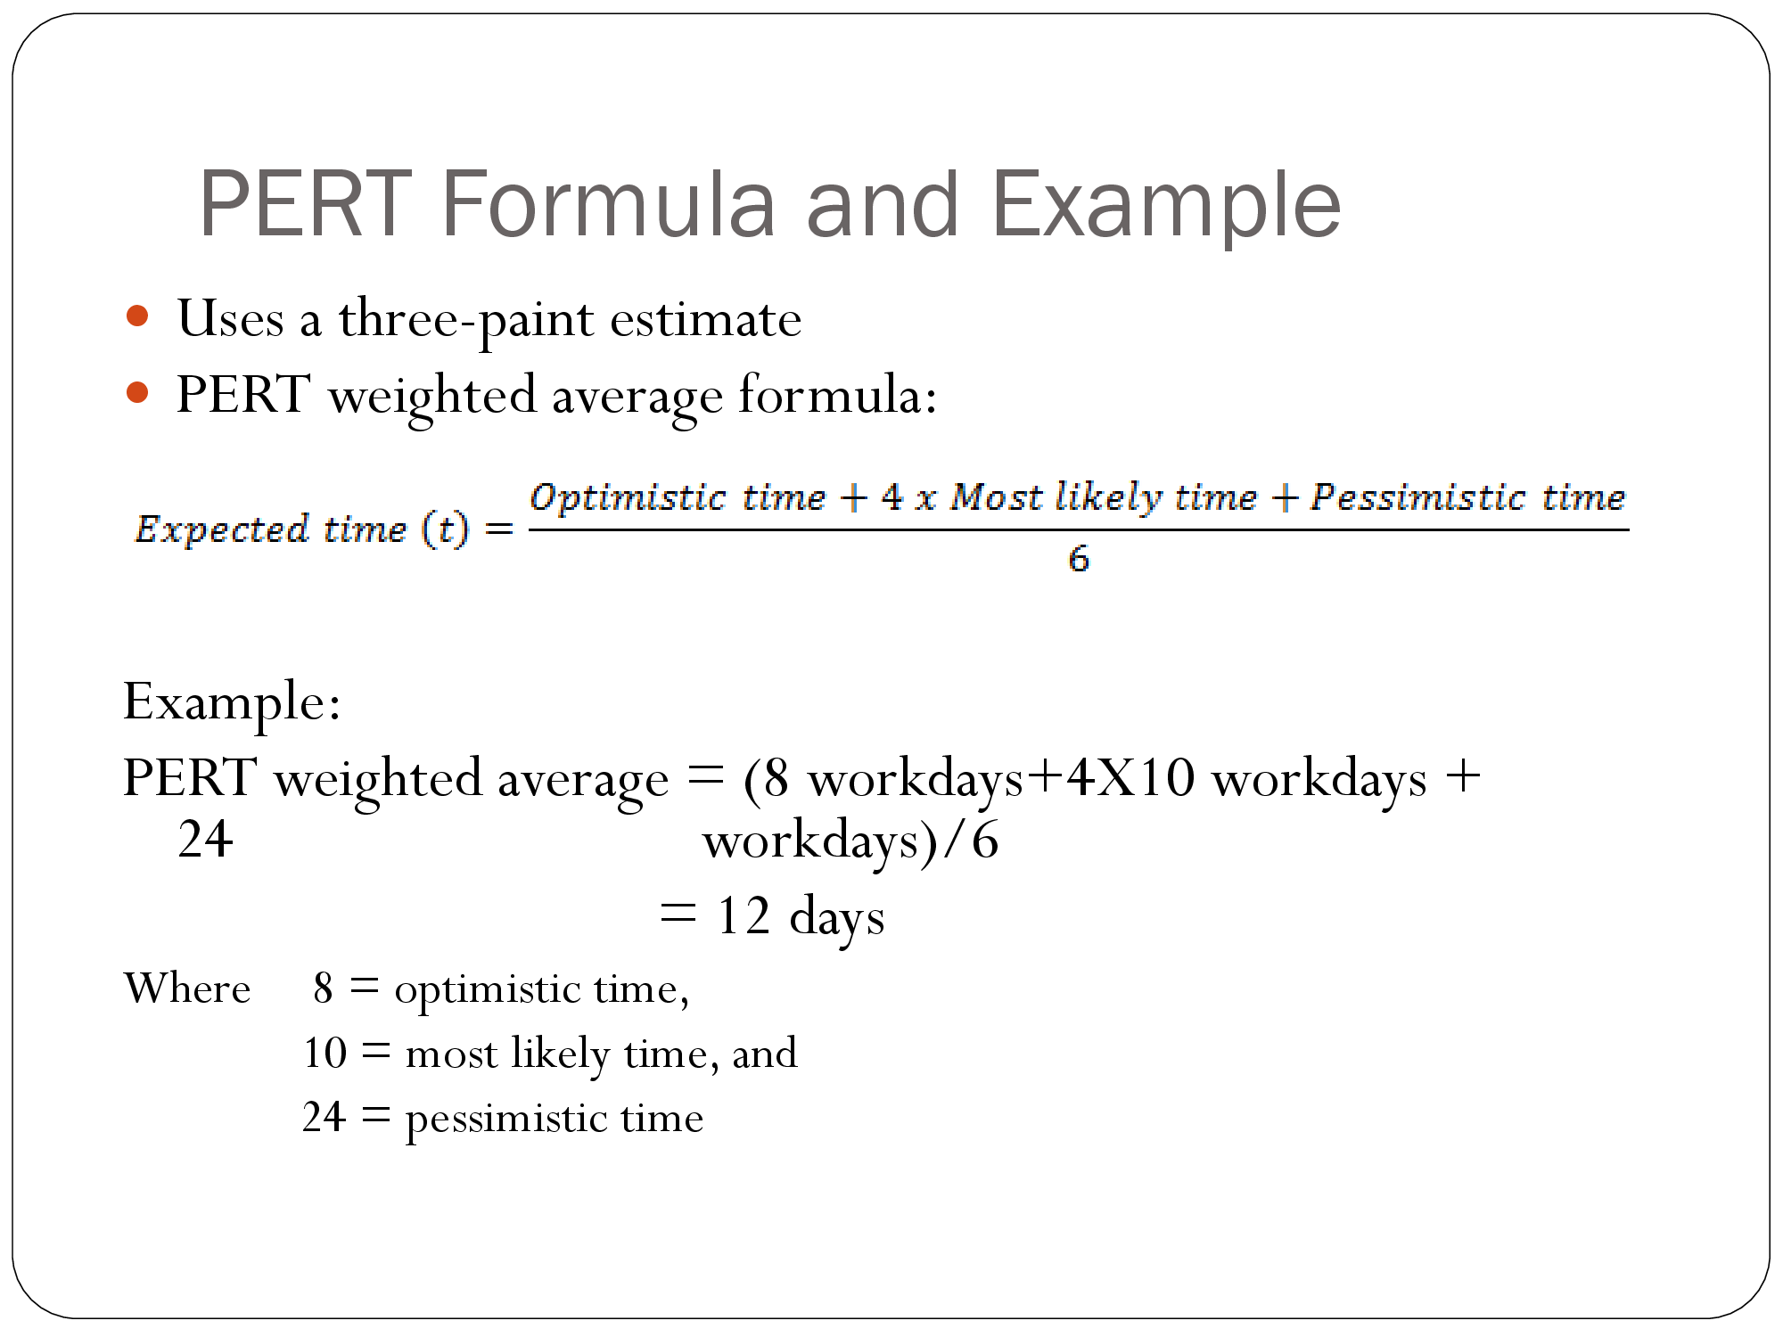

Slide 34
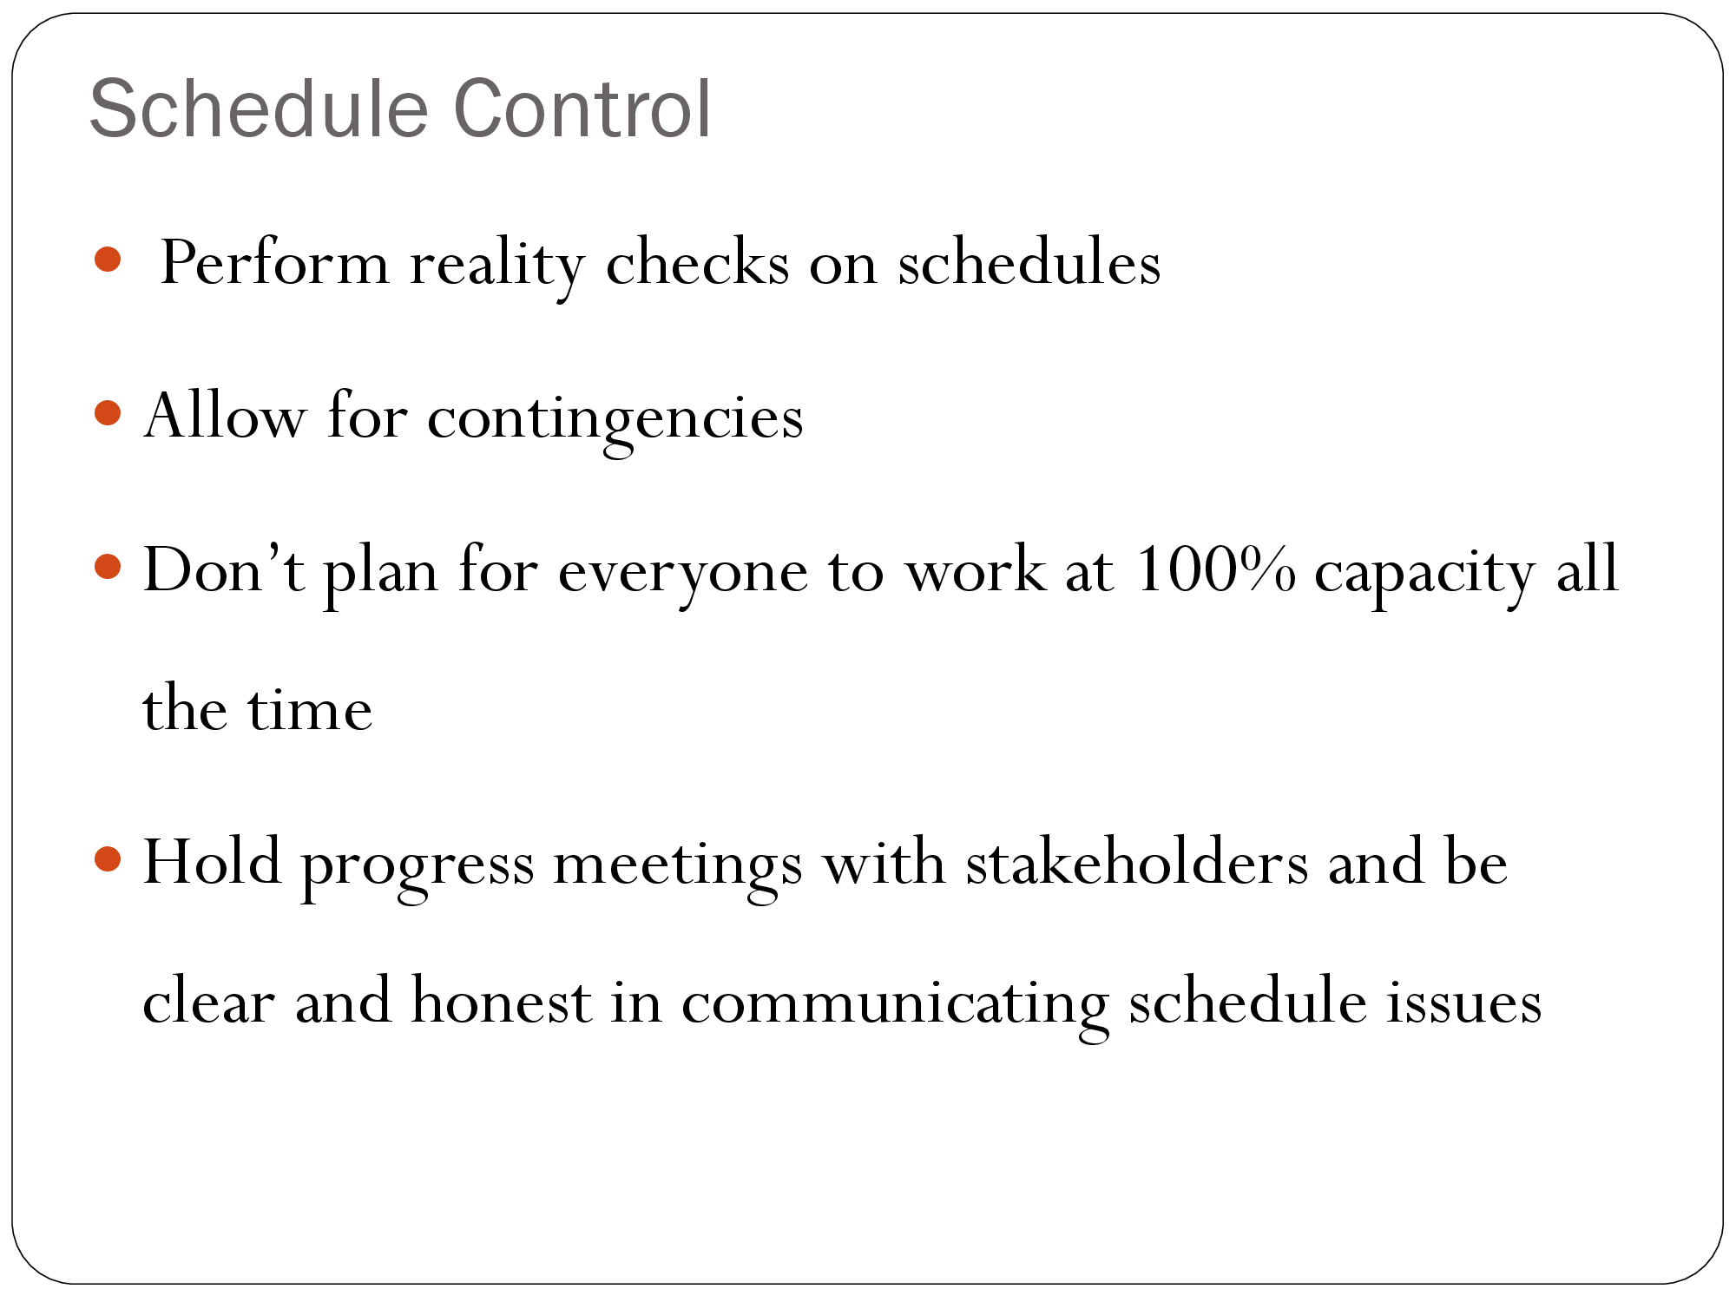

Slide 35
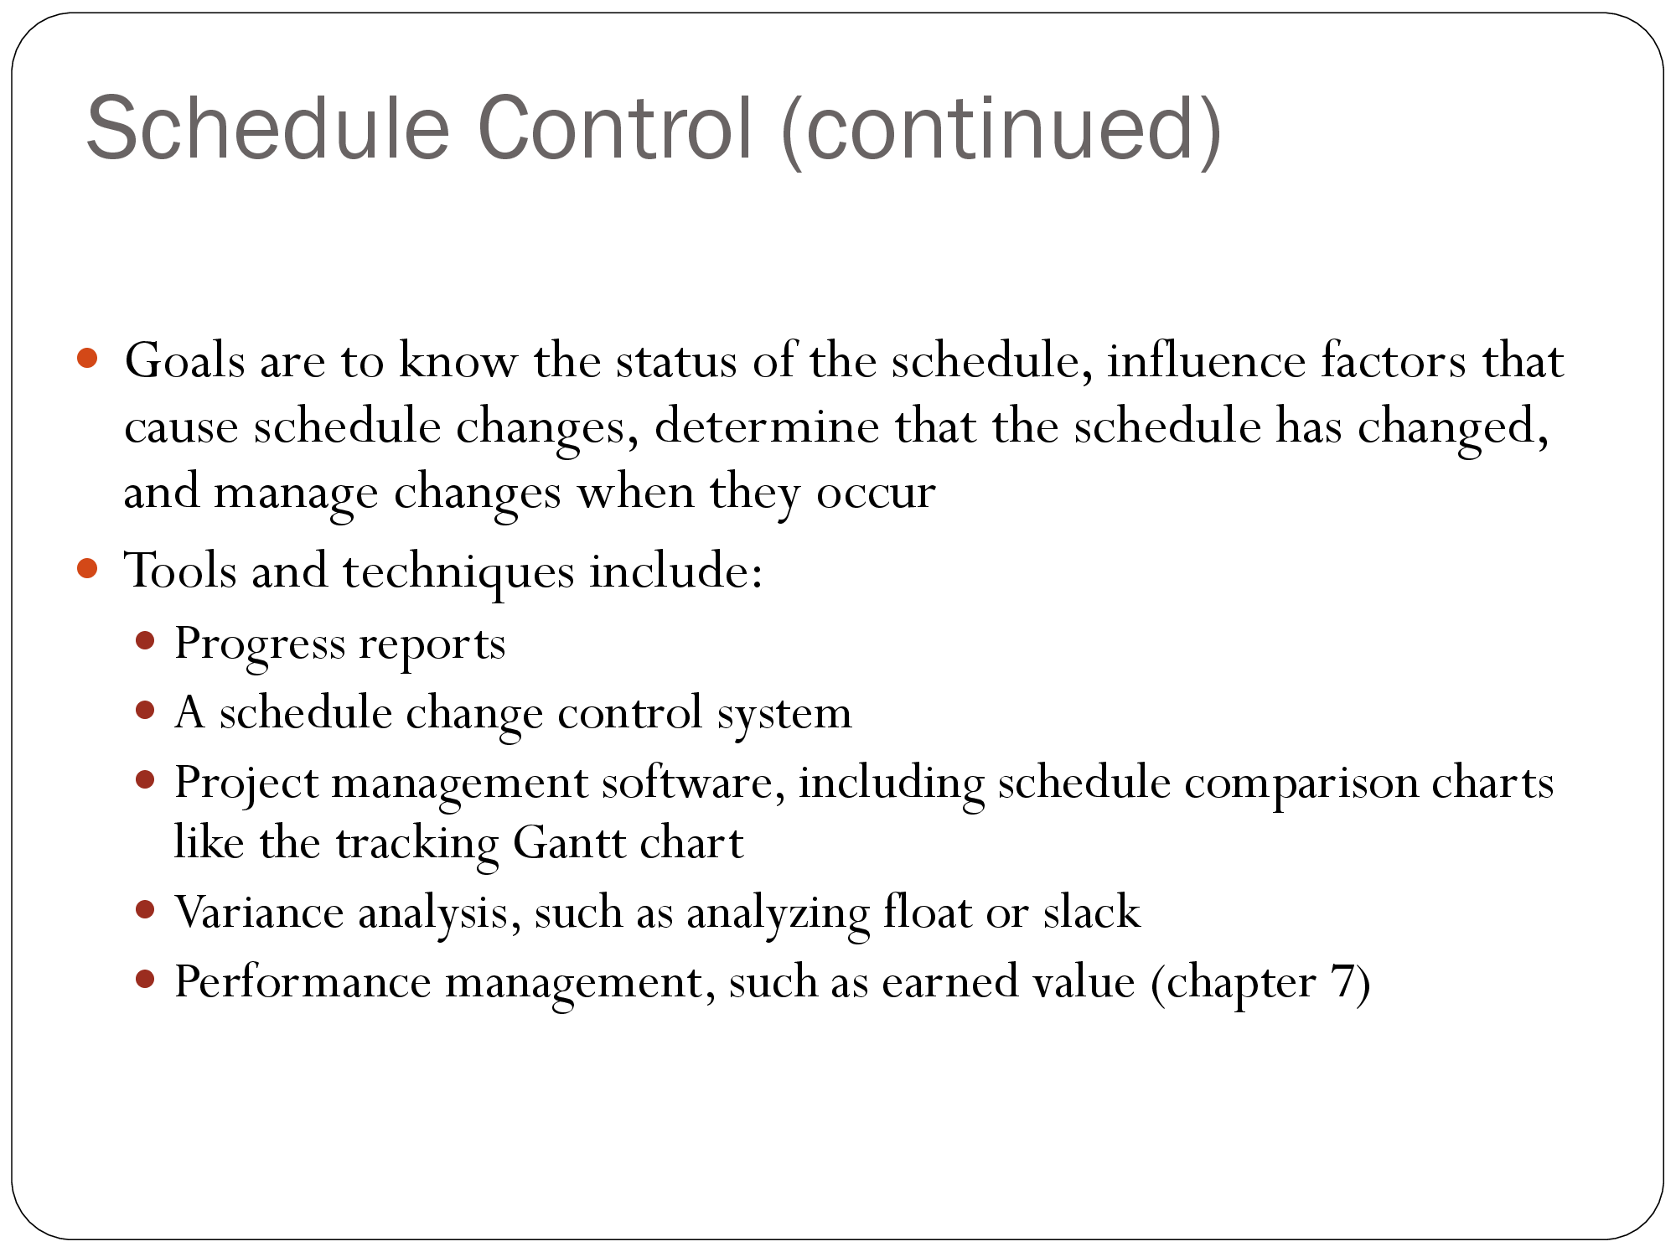

Slide 36
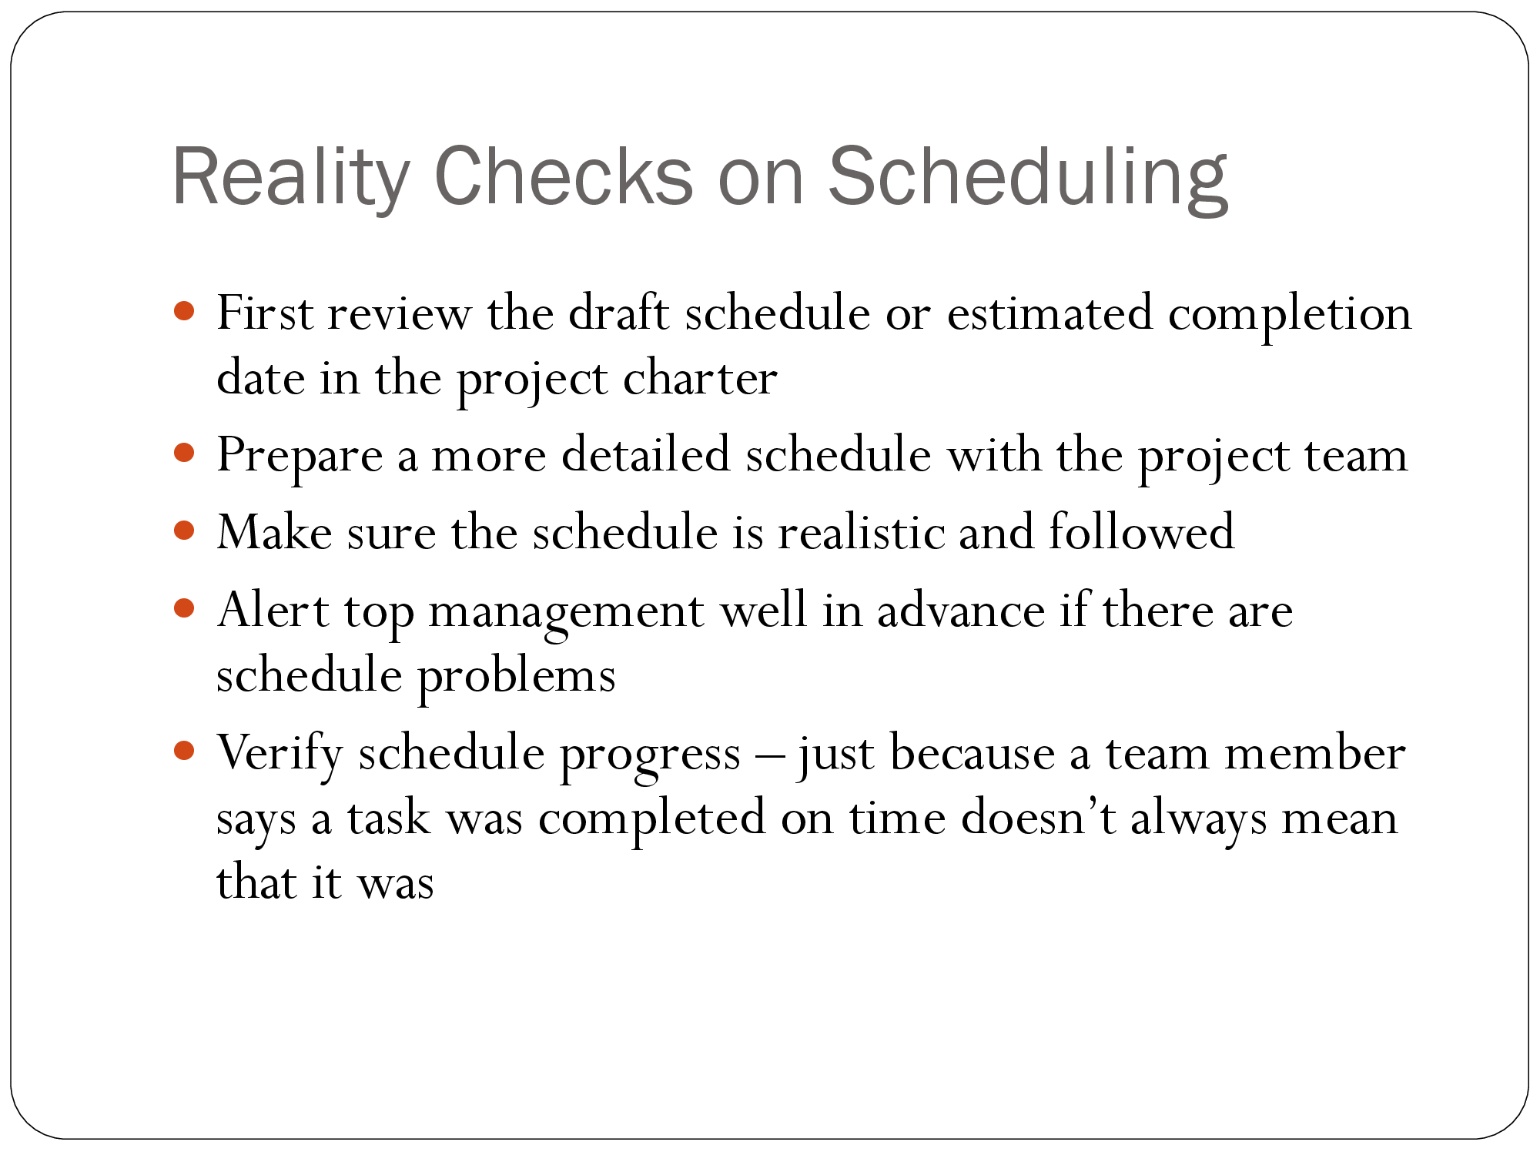

Slide 37
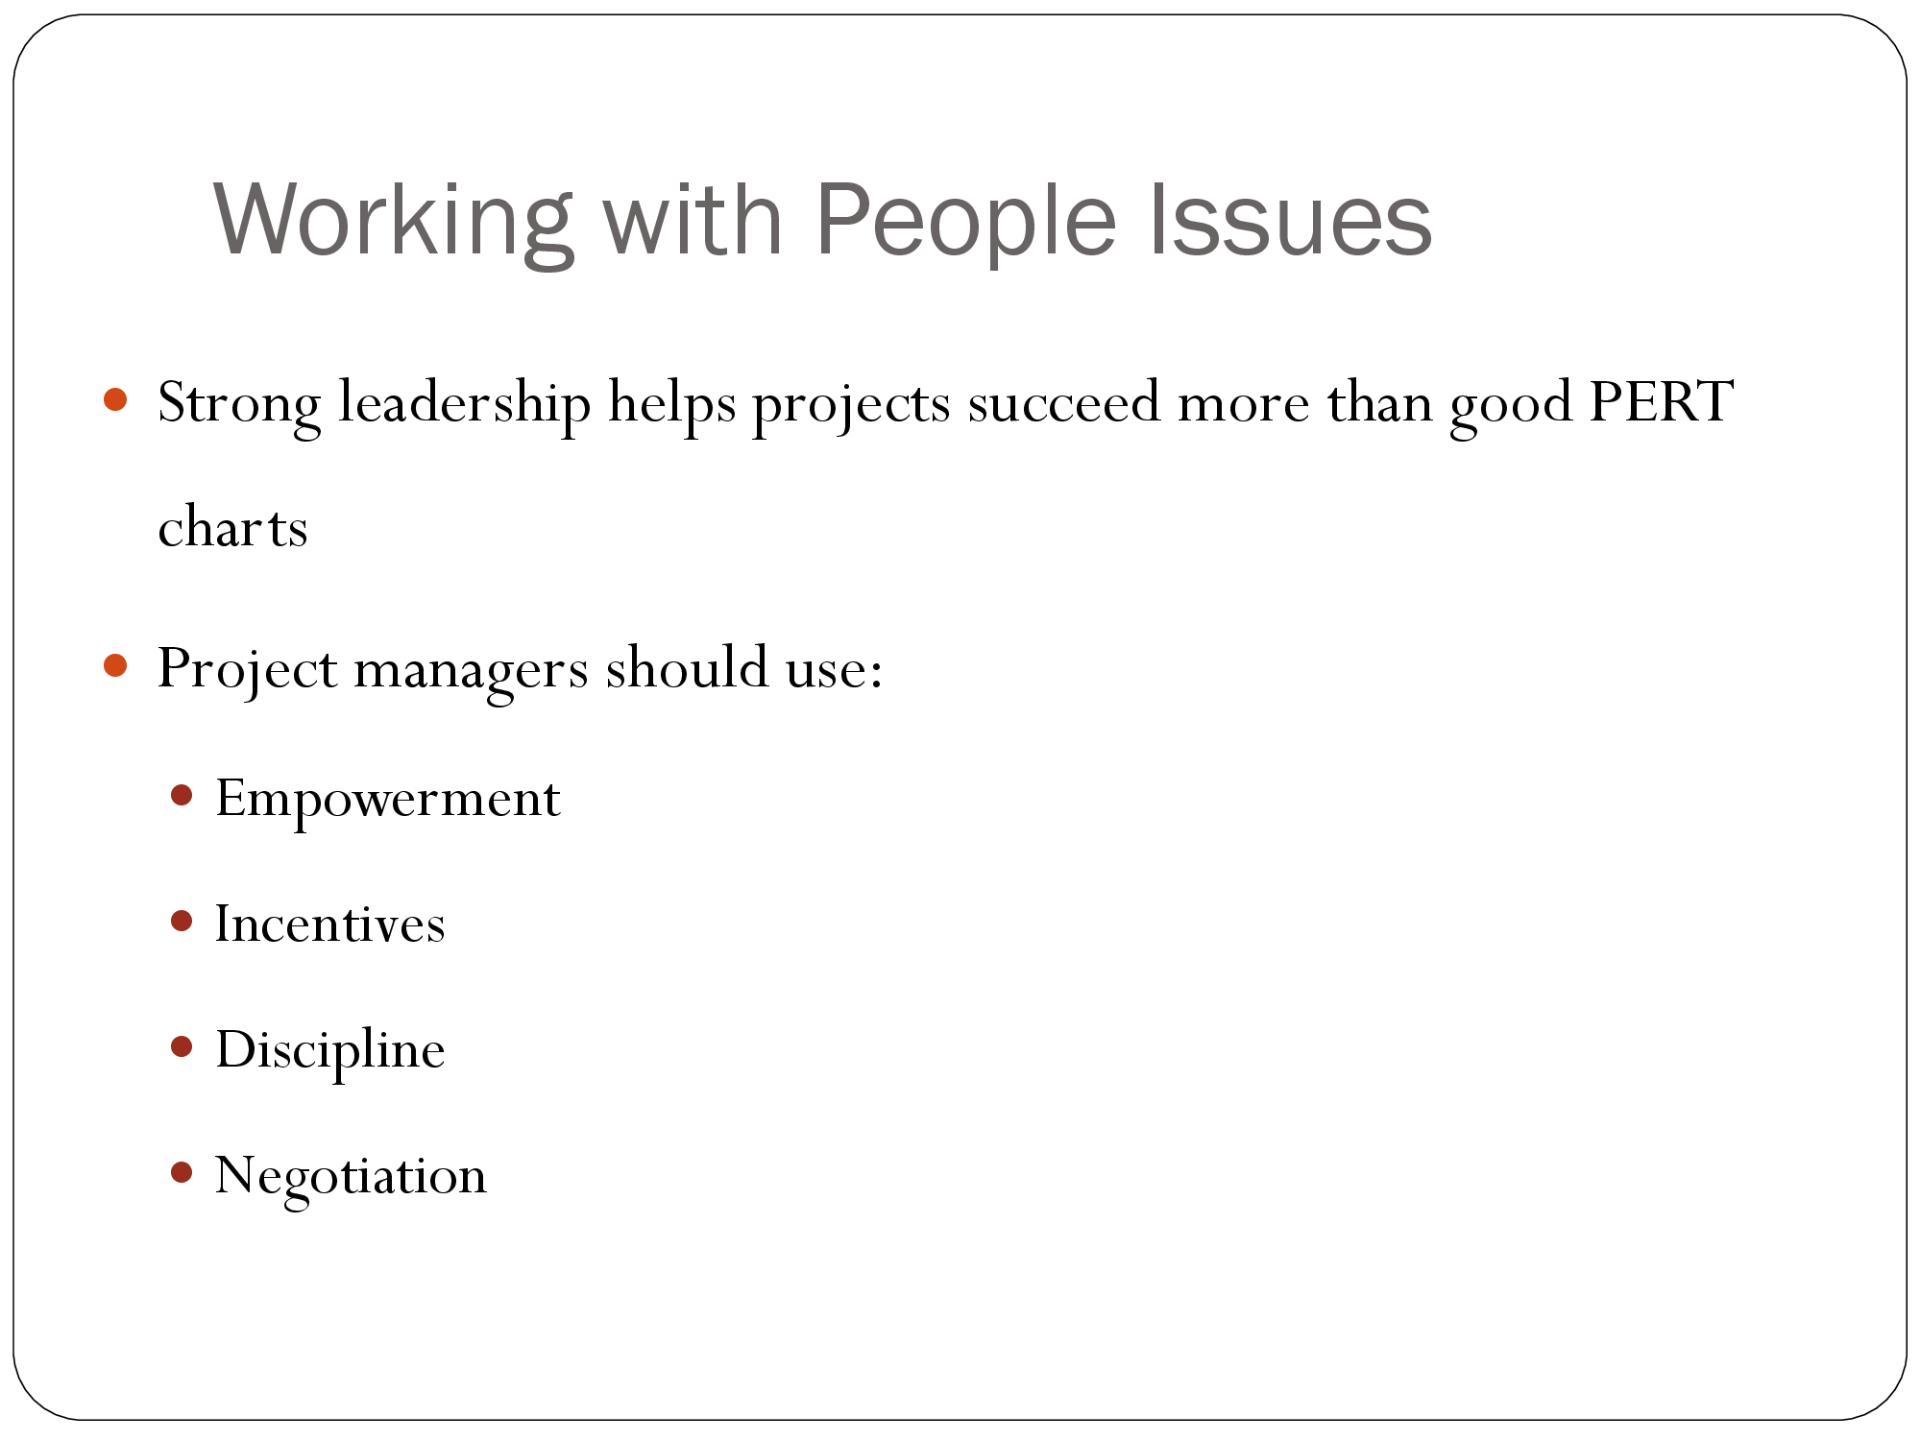

Slide 38


